Slide 1

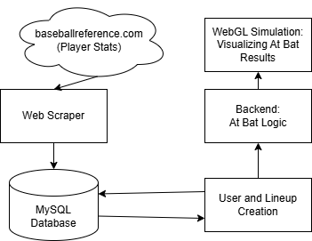
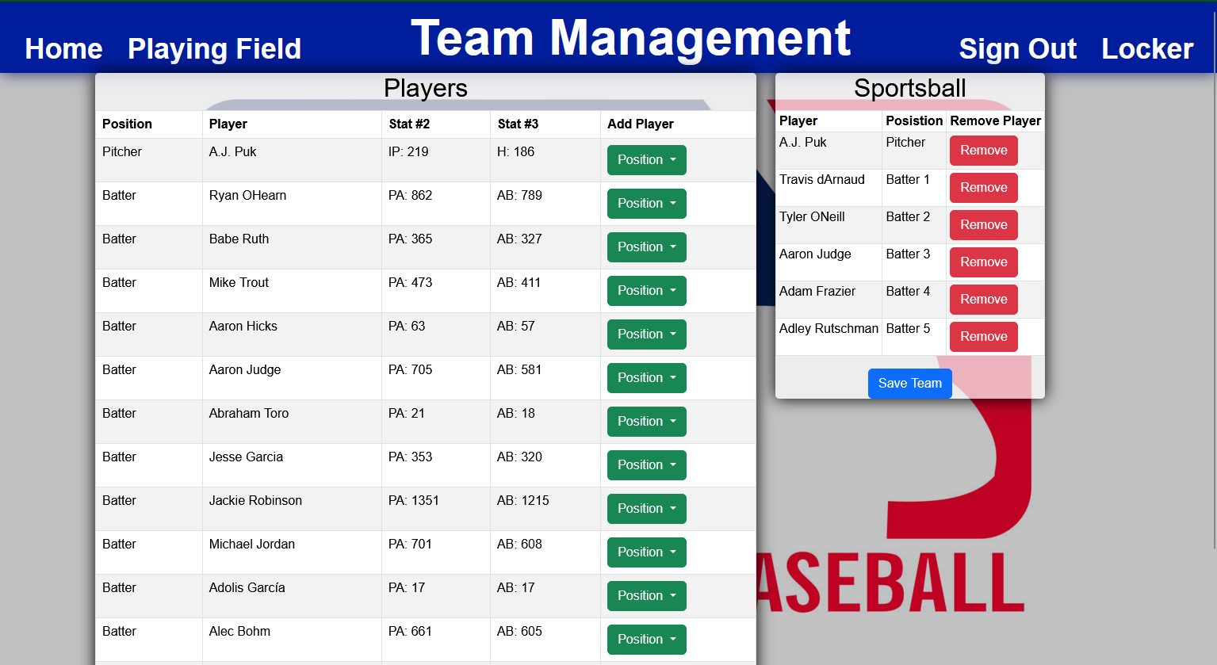
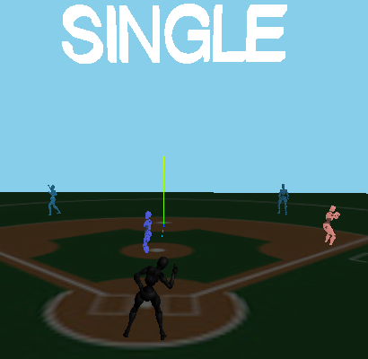
CSU Bakersfield
School of Natural Sciences, Mathematics, and Engineering
Sportsball
Visualization of Baseball Data
Jesse Garcia, Gustavo Jimenez, Aaron Pacheco, Nathan Wardinsky, Alejandra Zacarias
Sportsball is an interactive baseball website that uses real-world baseball data to predict the outcome of batter vs pitcher matchups through a baseball simulation. The main objective is to provide an engaging experience for fans, allowing them to visualize baseball analytics through an intuitive and interactive platform.
Project Architecture
Intro
Line Up Creation
Users are able to select their favorite batters and pitchers from any baseball era.
Web Scraper
Current MLB rosters are pulled from baseballreference.com where the individual player’s stats are saved on our database. We first pull the full team roster before inserting each individual player who played for them in the current year. Batters and Pitchers account for the different stats at their positions.
Conclusion
The architecture of this project can be described in 5 components
Web scraper pulling real life player data, both Present Day and Historical players
Database to facilitate pulled player data, user creation, and team lineups
Website for users to create team lineups
Backend At Bat Logic computes play outcomes based on Batter Vs. Pitcher stats
Front end WebGL simulation visualizing result of the play
Our project has given us invaluable experience in effective communication and technical skills. We also learned the importance of questioning assumptions and striving to have a deeper understanding of our work.
Database
The MySQL database is in charge of storing player data received by the web scraper, user accounts, and user generated player lineups.
At Bat Logic
Simulation
References
Batter’s and Pitcher’s stats are compared against one another to arrive at the probability of each outcome. We first start off with whether or not they put the ball in play, otherwise they walk or strikeout. If they put it in play we then see if it is a hit and how many bases their hit would award them with. We cycle throughout each lineup until the user wishes to end the simulation.
Player's stats are used as inputs for the simulation, the simulation is made using WebGL and JavaScript. The user may modify these parameters to create their own unique game scenario. Once all the parameters are filled, the simulation combines everything and displays key moments from the simulated game. Data manipulation and probabilities are displayed on the right side of the simulation.
Baseball Reference: www.baseball-reference.com
News API: www.newsapi.org
The Sports DB: www.thesportsdb.com
Sportsball Website: https://www.cs.csub.edu/~sportsball/project/main.php
Example of a play outcome
Department of Computer and Electrical Engineering and Computer Science

