Slide 1

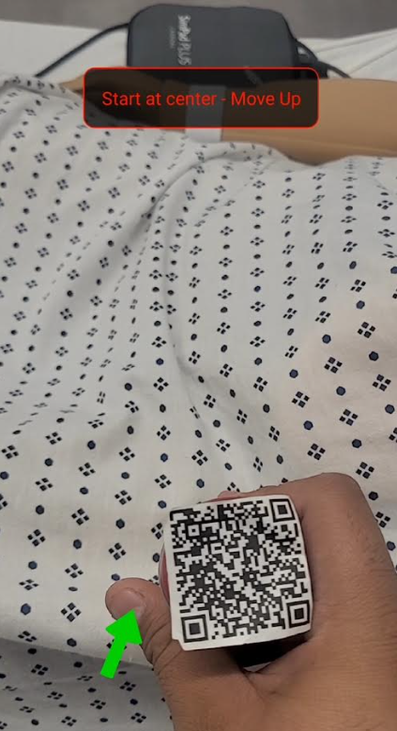
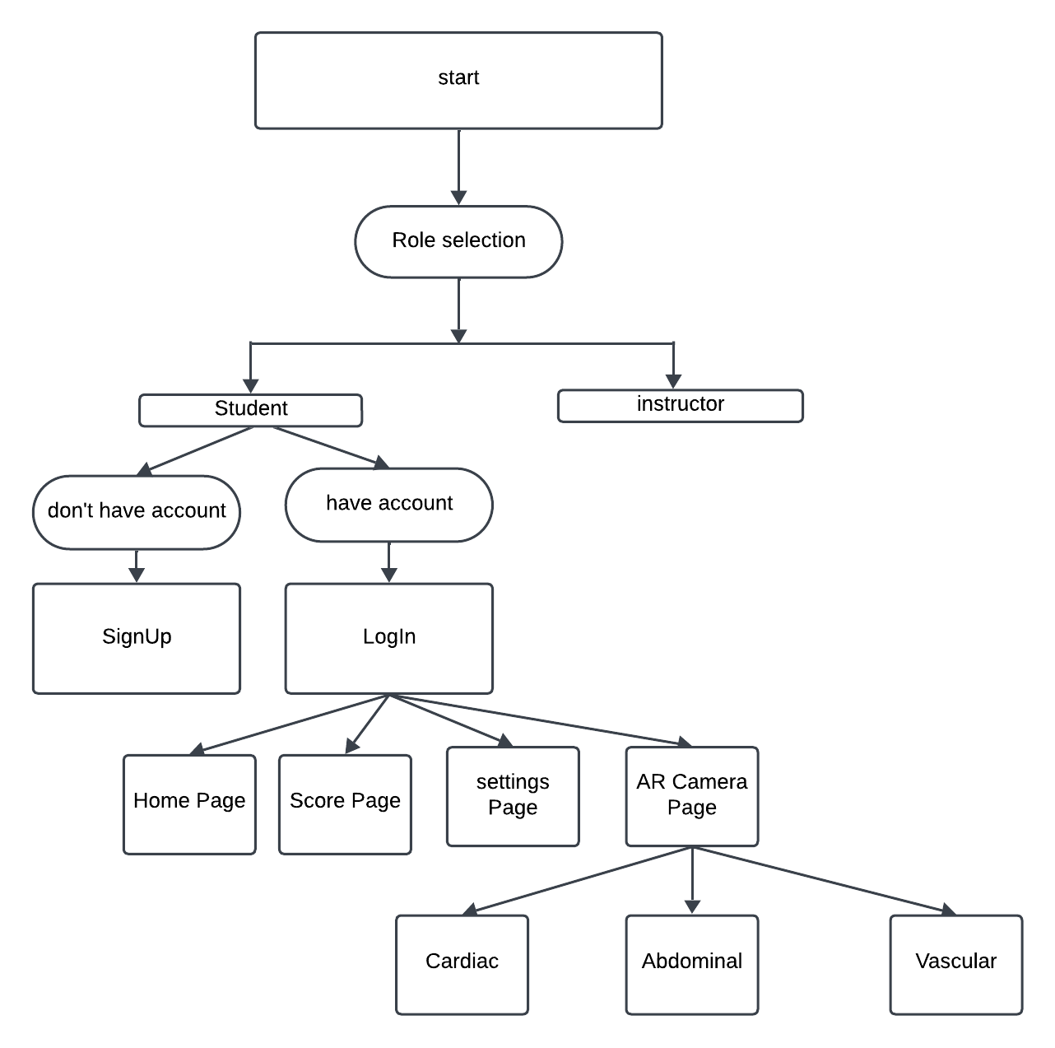
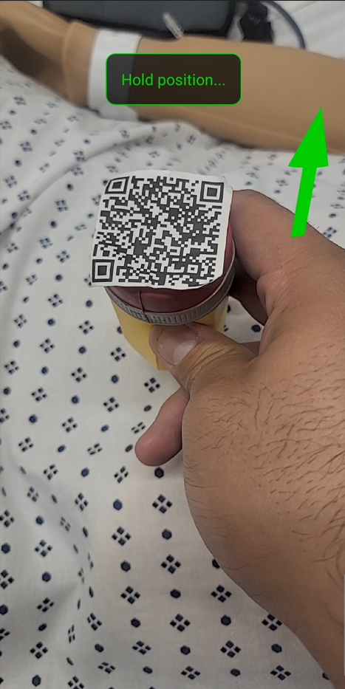
Augmented Reality Application for Object Detection and Interaction
Ultra AR
CSU Bakersfield
School of Natural Sciences, Mathematics, and Engineering
Joseph Rivera|Alia Almaitah
Project Summary
Our objective is to enhance learning and interaction through Augmented Reality (AR) by providing real-time guidance to users. The project utilizes advanced technologies to detect objects, offer instructions, delivering a hands-on learning experience.
Technologies Used
Frontend: React Native, JavaScript, ViroReact
Backend: Node.js, MongoDB
Augmented Reality: ARCore
Future Goals for Ultra AR
-Instructor Features: Add tutorials, quizzes, and AR simulations.
-Multi-Platform Support: Extend to iOS, web.
-Collaboration: Enable live mentoring and multi-user AR sessions.
Correctional Arrows:
How It Works
The app utilizes React Native and ViroAR for real-time image tracking to assist with ultrasound probe positioning. Users follow directional arrows and instructions, holding each position for 2 seconds. It tracks X and Y coordinates and provides feedback through on-screen notifications. With an AR view showcasing real-time data and 3D guidance, the app enhances the learning experience for medical professionals in ultrasound techniques.
.
When correctly placed:
Features
-3D Object Integration
-Displays interactive pointers using ARCore and ViroReact.
-Educational Assistance
-Helps students learn how to use complex devices through AR-based guidance.
-Integrates with a backend MongoDB database for storing user data
Conclusion
Our senior project involved developing an Augmented Reality (AR) application using React Native, MongoDB Atlas, and ViroReact. We gained experience in designing features for a distributed system, implementing secure API user authentication, and enhancing educational experiences with AR. This project improved our understanding of AR and backend integration.
Department of Computer and Electrical Engineering and Computer Science

