Slide 1

3D Tracking Simulation of Orbiting Satellites
Team Inner Ellipse

Slide 2
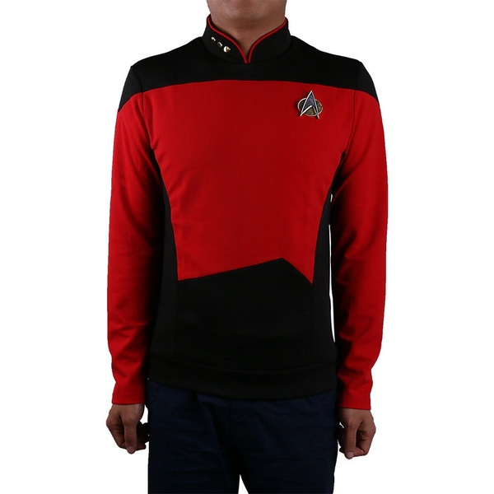
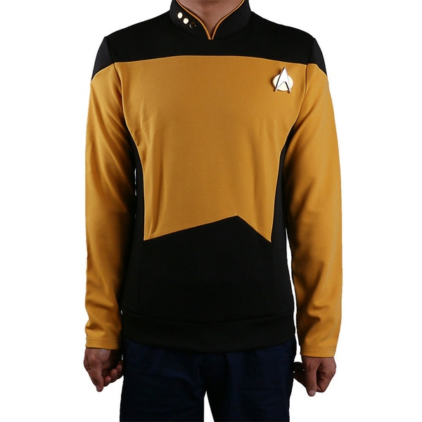
Meet the Team
Ivan
Cisneros
Thang
Hin
Joey
Hubbard
The Database Guy
The Graphics Guy
The TLE Guy
Doney
Peters
The Guy
Created by Ivan Cisneros

Slide 3


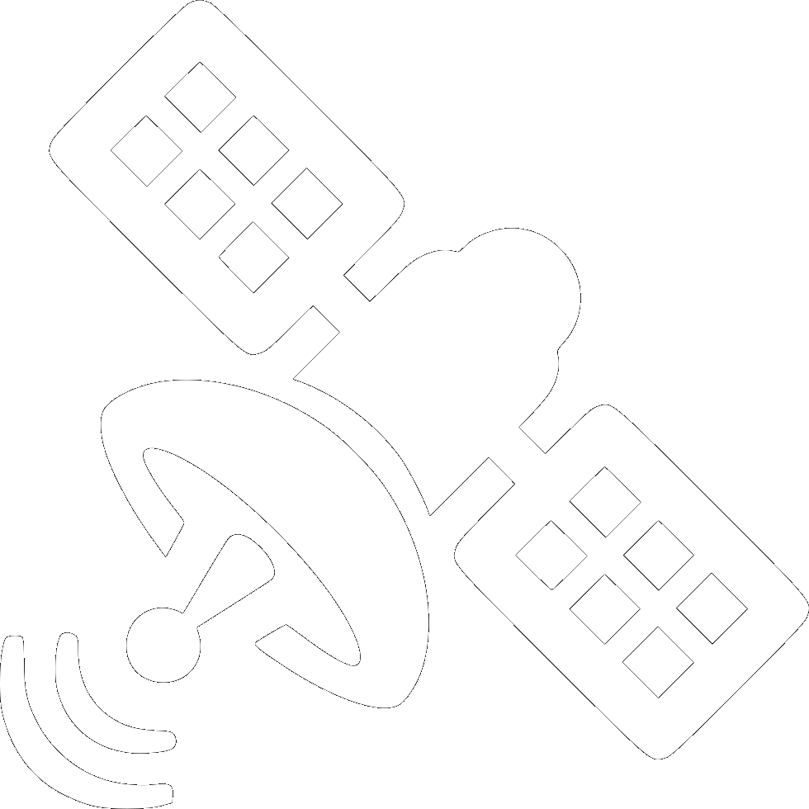


Overview of the Previous Semester
Team Creation
Data Gathering
Unity
MongoDB
Demo
Established ideas, goals, and roles.
Gathering of information and tools for project.
Simulation of one satellite orbiting Earth.
Creation of database to store TLE data.
Presentation of project at more than 50% completion

Slide 4

“First” Day to Now
Web Application Marketability
  Contacted physics department chair, Dr. Dzyubenko.
  AIAA Student Conference Call for Papers abstract submission.
  Kern County School District teacher meeting.
Improved design of web page.
Swapping of 3rd party libraries for in house functionality.
Website hosting deployment options.

Slide 5
ACHIEVEMENTS/
GOALS
More buttons!! Add camera controls to UI
Correct scaling of objects’ size and velocity
Create a variety of database queries that will enhance the user’s experience
Missile Command Mode
For our project this semester

Slide 6
Estimated Senior Project II Timeline
-> Finish persistent fetch to
Space-Track
-> *Start of achievement*
-> 75% Completion
-> 2nd Reintegration of components
-> Preparations for Senior Expo
presentation
- > 95% Completion
-> Final Presentation
-> *Achievement/Goal Completed*
02/06
03/19
05/07
02/27
04/30
00
-> Finalize achievable front-end
deliverables and features
-> Integration to MongoDB Atlas
-> 85% Completion
-> Begin final modifications
-> Maintenance and Consumer
Review
-> 100% Completion

Slide 7
MILESTONES
Finish the project and documentation
Submit paper to AIAA (American Institute of Aeronautics and Astronautics
Submit project to Celestrak and heavens-above website

Slide 8
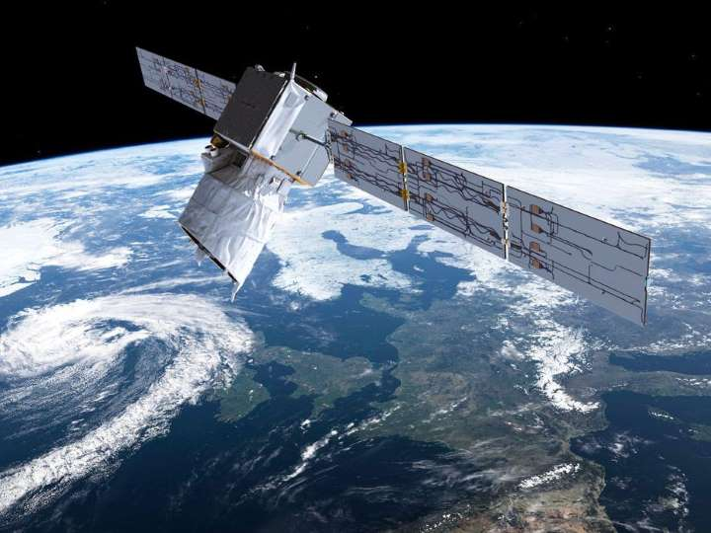

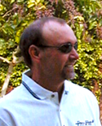
Questions?

