Slide 1
Campus Data For Geo-Location Based Augmented Reality
By
Cesar Aleman
Spencer Austin
Andrew Burt
Rodrigo Ortiz

Slide 2
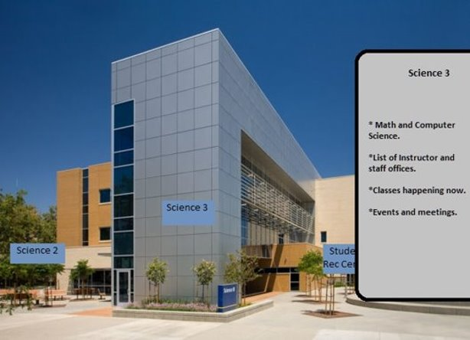
Concept

Slide 3
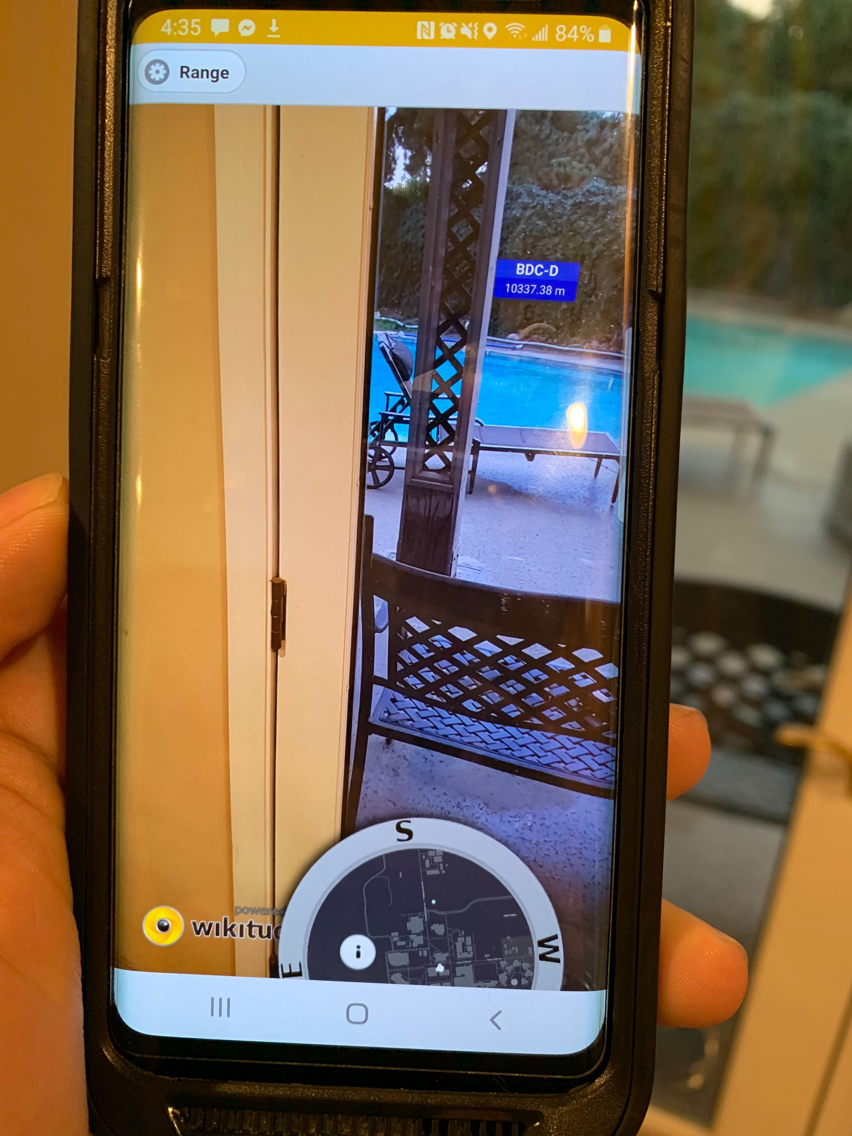
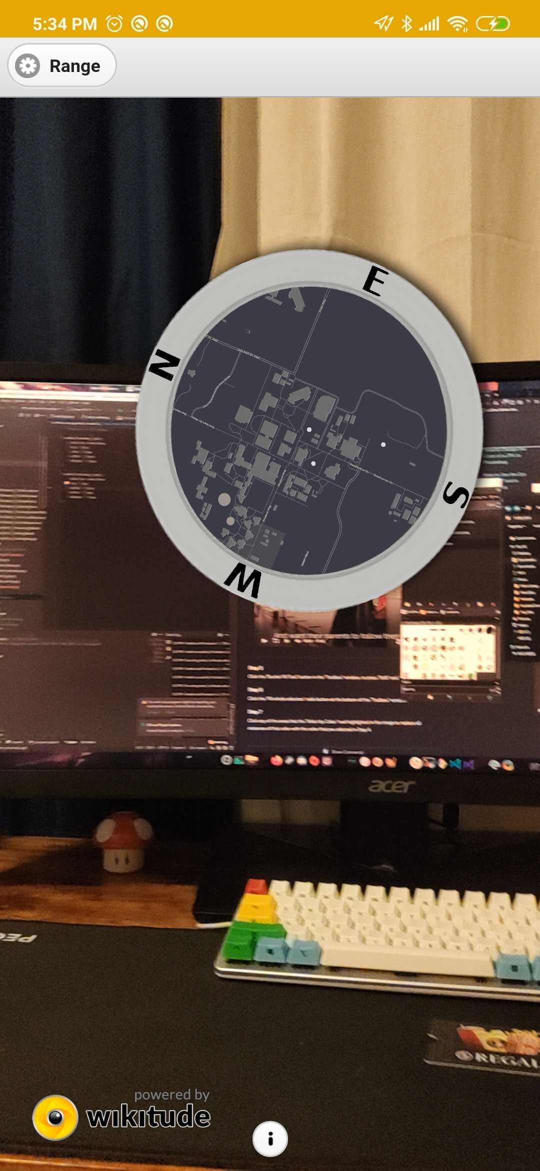
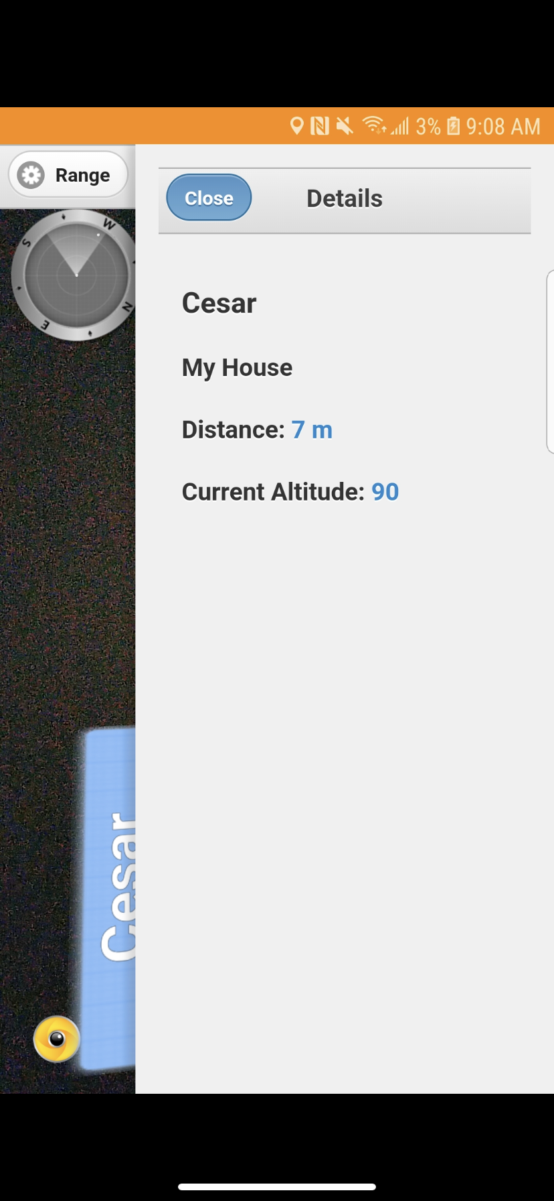
Example of our application

Slide 4

Goals
Our current main goal is to get CSUB onboard with this app.
  There is already work to make something similar to this.
We have reached out to the ITSS Director, Rich Nelson
  We have all worked or are working for ITS at the moment.
  Rich has let us know that he would also like the Enterprise Applications director present for this meeting.
  Meeting is still yet to be scheduled as time conflicts have been occurring.

Slide 5


Potential Ideas
Kern County Fair
  Smaller scale goal that seems achievable
Amusement Parks
  Larger scale goal!

Slide 6

Progress
At the moment we are around 85% done with the project. We are looking into possible additions to the application while simultaneous squashing the plethora of bugs.
This Photo by Unknown author is licensed under CC BY-SA.

