Slide 1
ArcGIS Historical Interactive Atlas
Justin Alejo, Marvin Nurmagomedov Estrada, Adam Albert Ilarde, Raul Velasco

Slide 2

What will be ArcGIS Historical Interactive Atlas (AHIA)
Interactive web based chronological atlas
Visual timelines
personal experiences and historical events.
Dynamic nature

Slide 3

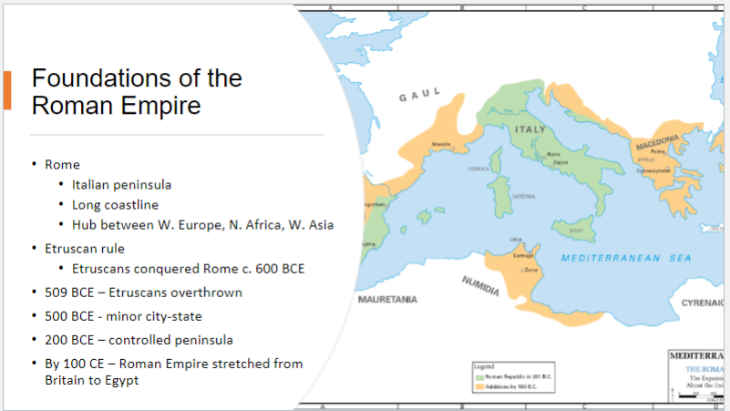
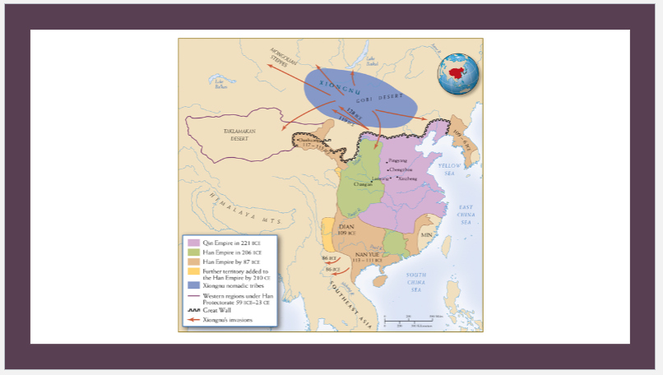
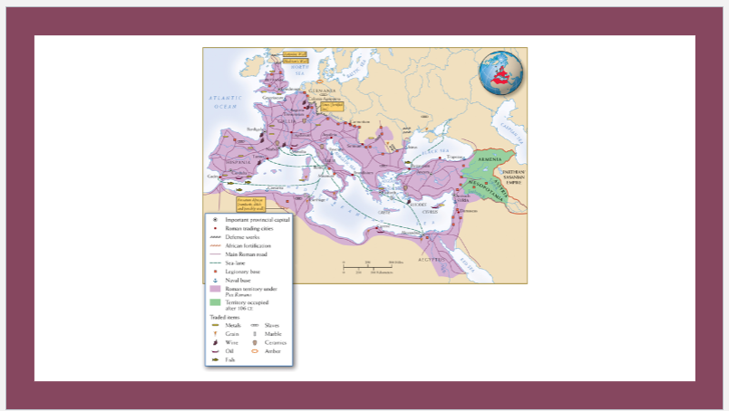
Choosing the problem
Identified issue:
Difficulty in connecting historical events leads to a sense of disconnect and lack of relevance.
PowerPoints are static and limited
Extended Purpose:
Recognize the atlas’s potential for various applications beyond history, including personal ancestral documentation.

Slide 4


Frontend and framework
HTML, CSS, JavaScript used for interface
React.js for backend communication and ArcGIS API queries
Central map display with toolbar (editing tools)
Bottom timeline for year navigation
Right-side media display based on interactions
Left-side filters for topics
Top banner for collaboration and sharing
Chronological Atlas with multimedia

Slide 5
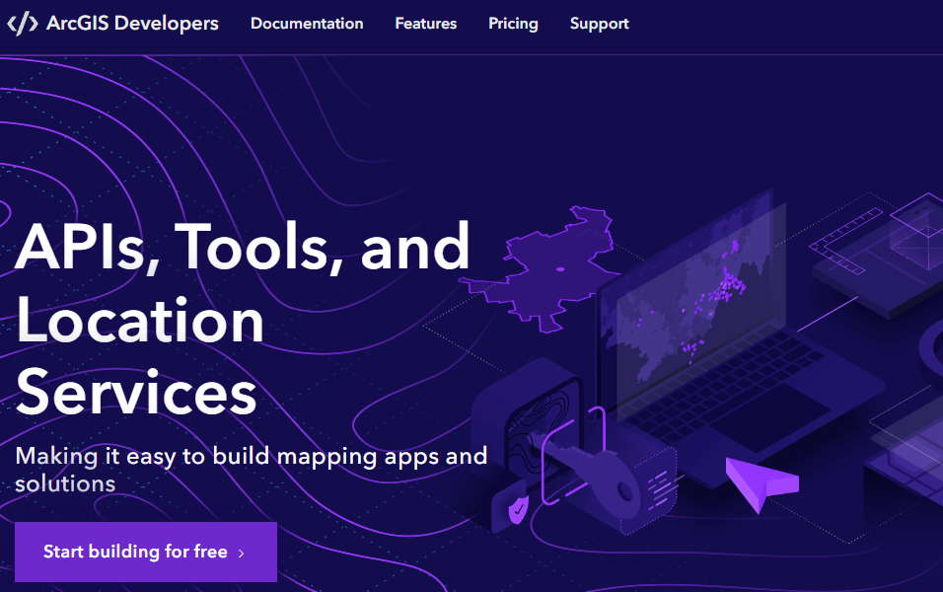

ArcGIS API Integration
ArcGIS is a cloud-based mapping and analysis solution. Used to make maps, analyze data, and to share and collaborate.
Utilize ArcGIS API for dynamic geographical visualizations.
Allow users to add their own data without subscription fees.
Implement ArcGIS API calls in backend code for data retrieval and processing.
Enable customization of user data for enriched exploration across domains.
Facilitate seamless integration with frontend for interactive map display and user interactions.

Slide 6


Backend and database management
Comprehensive Database Schema:
Designing using PostgreSQL.
Tables for entities: geospatial data, pictures, videos, audio, text, user info etc.
Establishing relationships with foreign key constraints for data integrity
Writing PHP scripts for:
Handling HTTP requests.
Executing SQL queries for database interaction.
Managing user input, querying, and response generation.

Slide 7


Server housing
Cloud computing vendor that offers an infrastructure as a service for software developers
Primary offering are for app and website hosting
We selected Ubuntu as our Operating System for its widespread use, extensive community support, and security features
Ubnuntu is also known for its stability, regular updates, and compatibility with a wide range of software
It also offers a flexible and customizable environment ideal for server hosting and development

Slide 8
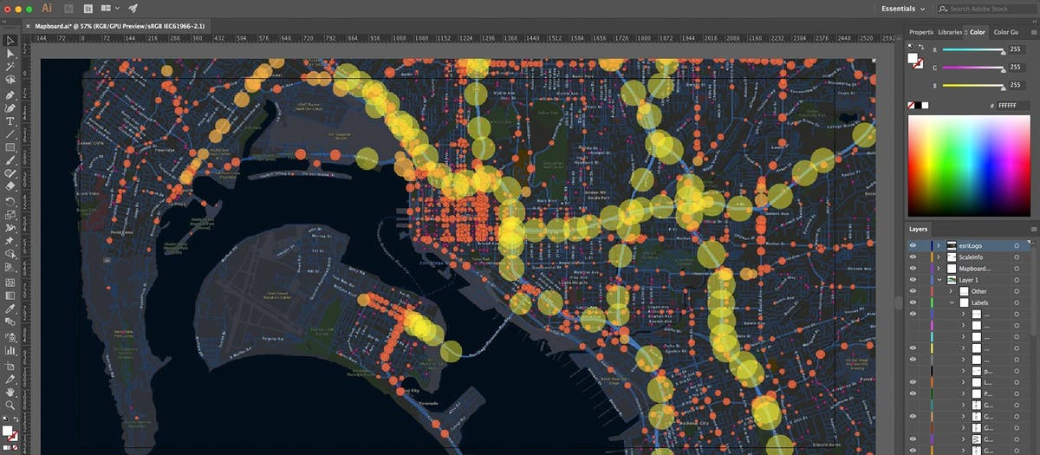
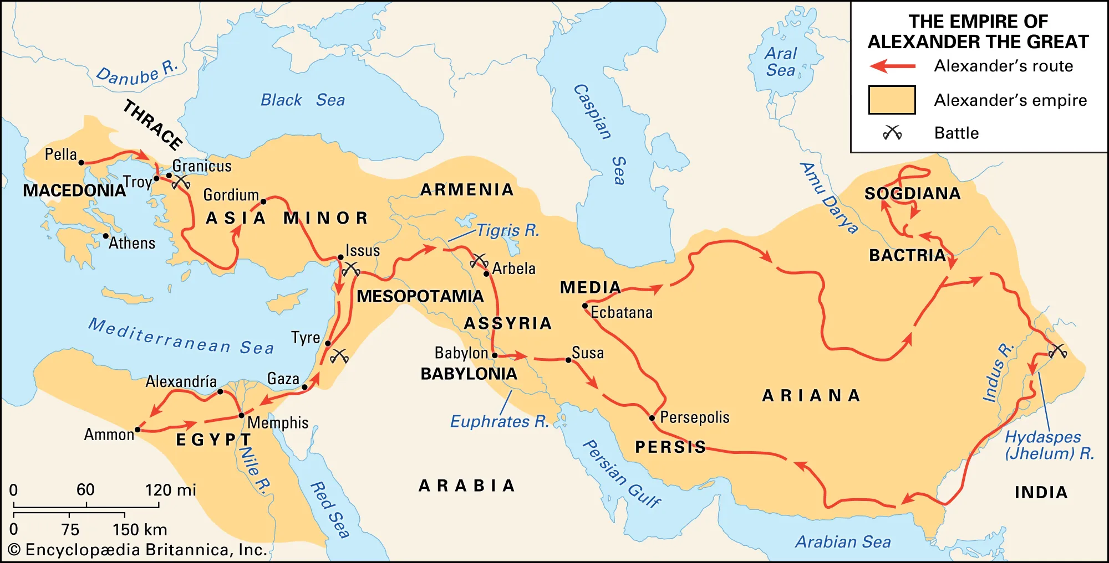
Conclusion
Plan to create a platform for people to use for historical narratives and show a timeline of events.
Interactive webpage that people can customize and upload different forms of media to share and collaborate with others.
Utilize ArcGIS API and program it in a way that users can add and save their own data on an online geographical interface.
Collaborate with the History department to fine tune/ add more features.

