Slide 1
Visualization of Sports Data
Team Sportsball
Aaron Pacheco, Nathan Wardinsky, Alejandra Zacarias, Gustavo Jimenez

Slide 2
Background
Baseball has a long history dating back to the 19th century
Such a long history has come with a trove of player statistics
In 1980, statistician Bill James developed “Sabermetrics” a scientific analysis of baseball stats, explaining how teams win or lose

Slide 3
Problem
Baseball is a very stat heavy game that can be confusing to new fans.
Baseball teams and older fans sometimes do not accurately assign value to certain attributes of players or they will over value less important factors when evaluating a player or team.

Slide 4
Solution
Develop an interactive website that simplifies baseball stats for less experienced fans through visualizations.
Provide educated predictions using probability
By applying sabermetrics, we can calculate win probability based on a player’s stats and the game’s current state

Slide 5
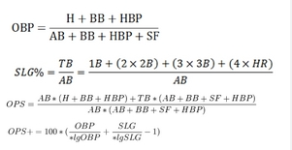

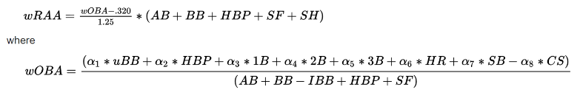
Implementation
Pull Data with an API from Baseball Reference
Put pulled stats into equations designed to objectively measure players
Make the data easy to understand for the user and explain how they should value the player with the given data.
Make predictions using probability to try and predict future outcomes in upcoming games.

Slide 6
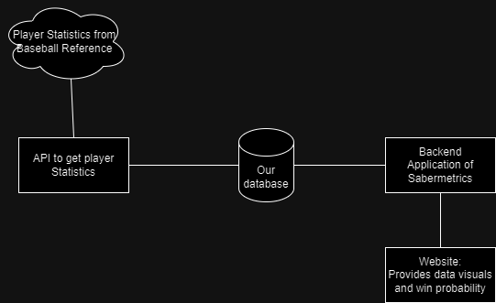
Flowchart

Slide 7
Potential Issues
Automatically obtaining data in the correct format, as opposed to manual setup
Data storage should allow easy filtering, enabling users to utilize the information at their discretion for interactivity
Ensuring the website is user-friendly and the visuals are easily comprehensible

