Slide 1
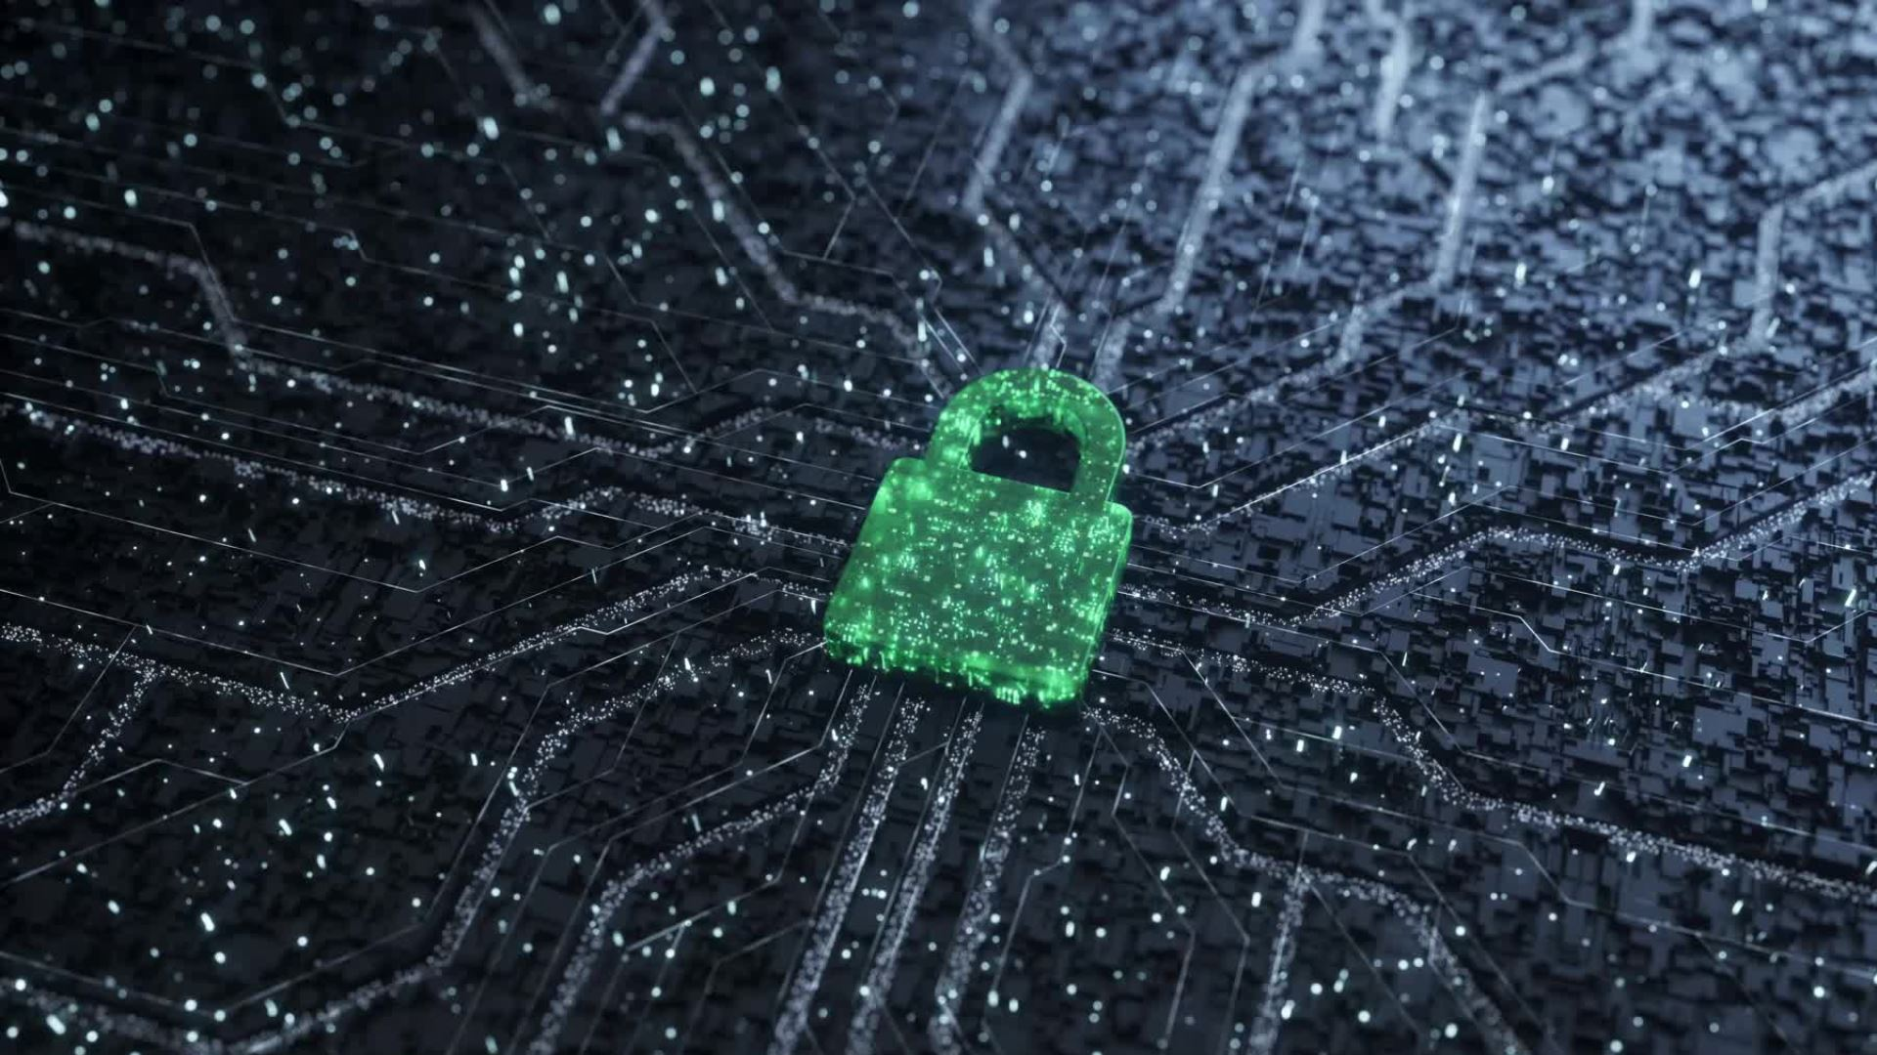
File Storage using Facial Pattern-based Encryption
John Pocasangre Jacob Acosta
Carlos Sandoval Andrew Ibrahim

Slide 2
Introduction
What the project?
A system for storing files using a unique encryption method involving facial-pattern recognition and multi-layered authentication.
What will it do?
The project will provide a storage system that will ensure security of multimedia files being stored.

Slide 3
Background
Why did we choose this as our project?
We are interested in privacy/security. Companies nowadays sell information or data online for profit which can feel invasive.
We wanted to provide a way for people to store information without ever feeling precarious about the data stored.

Slide 4
Implementation
Front End Tools
ReactJS
CSS
HTML
Back End Tools
Go
Python
PostgreSQL

Slide 5
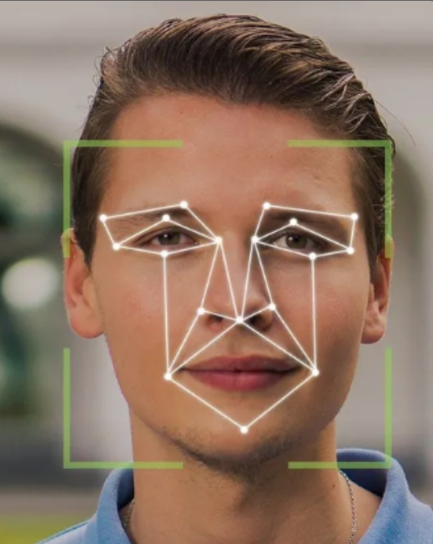
Why encryption?
We initially wanted to work on something in relation to file storage as well as multifactored authentication. After getting some advice, we landed on using a unique way to safely store files on top of using Multifactored authentication. This will involve using facial recognition as the base for encryption.

Slide 6
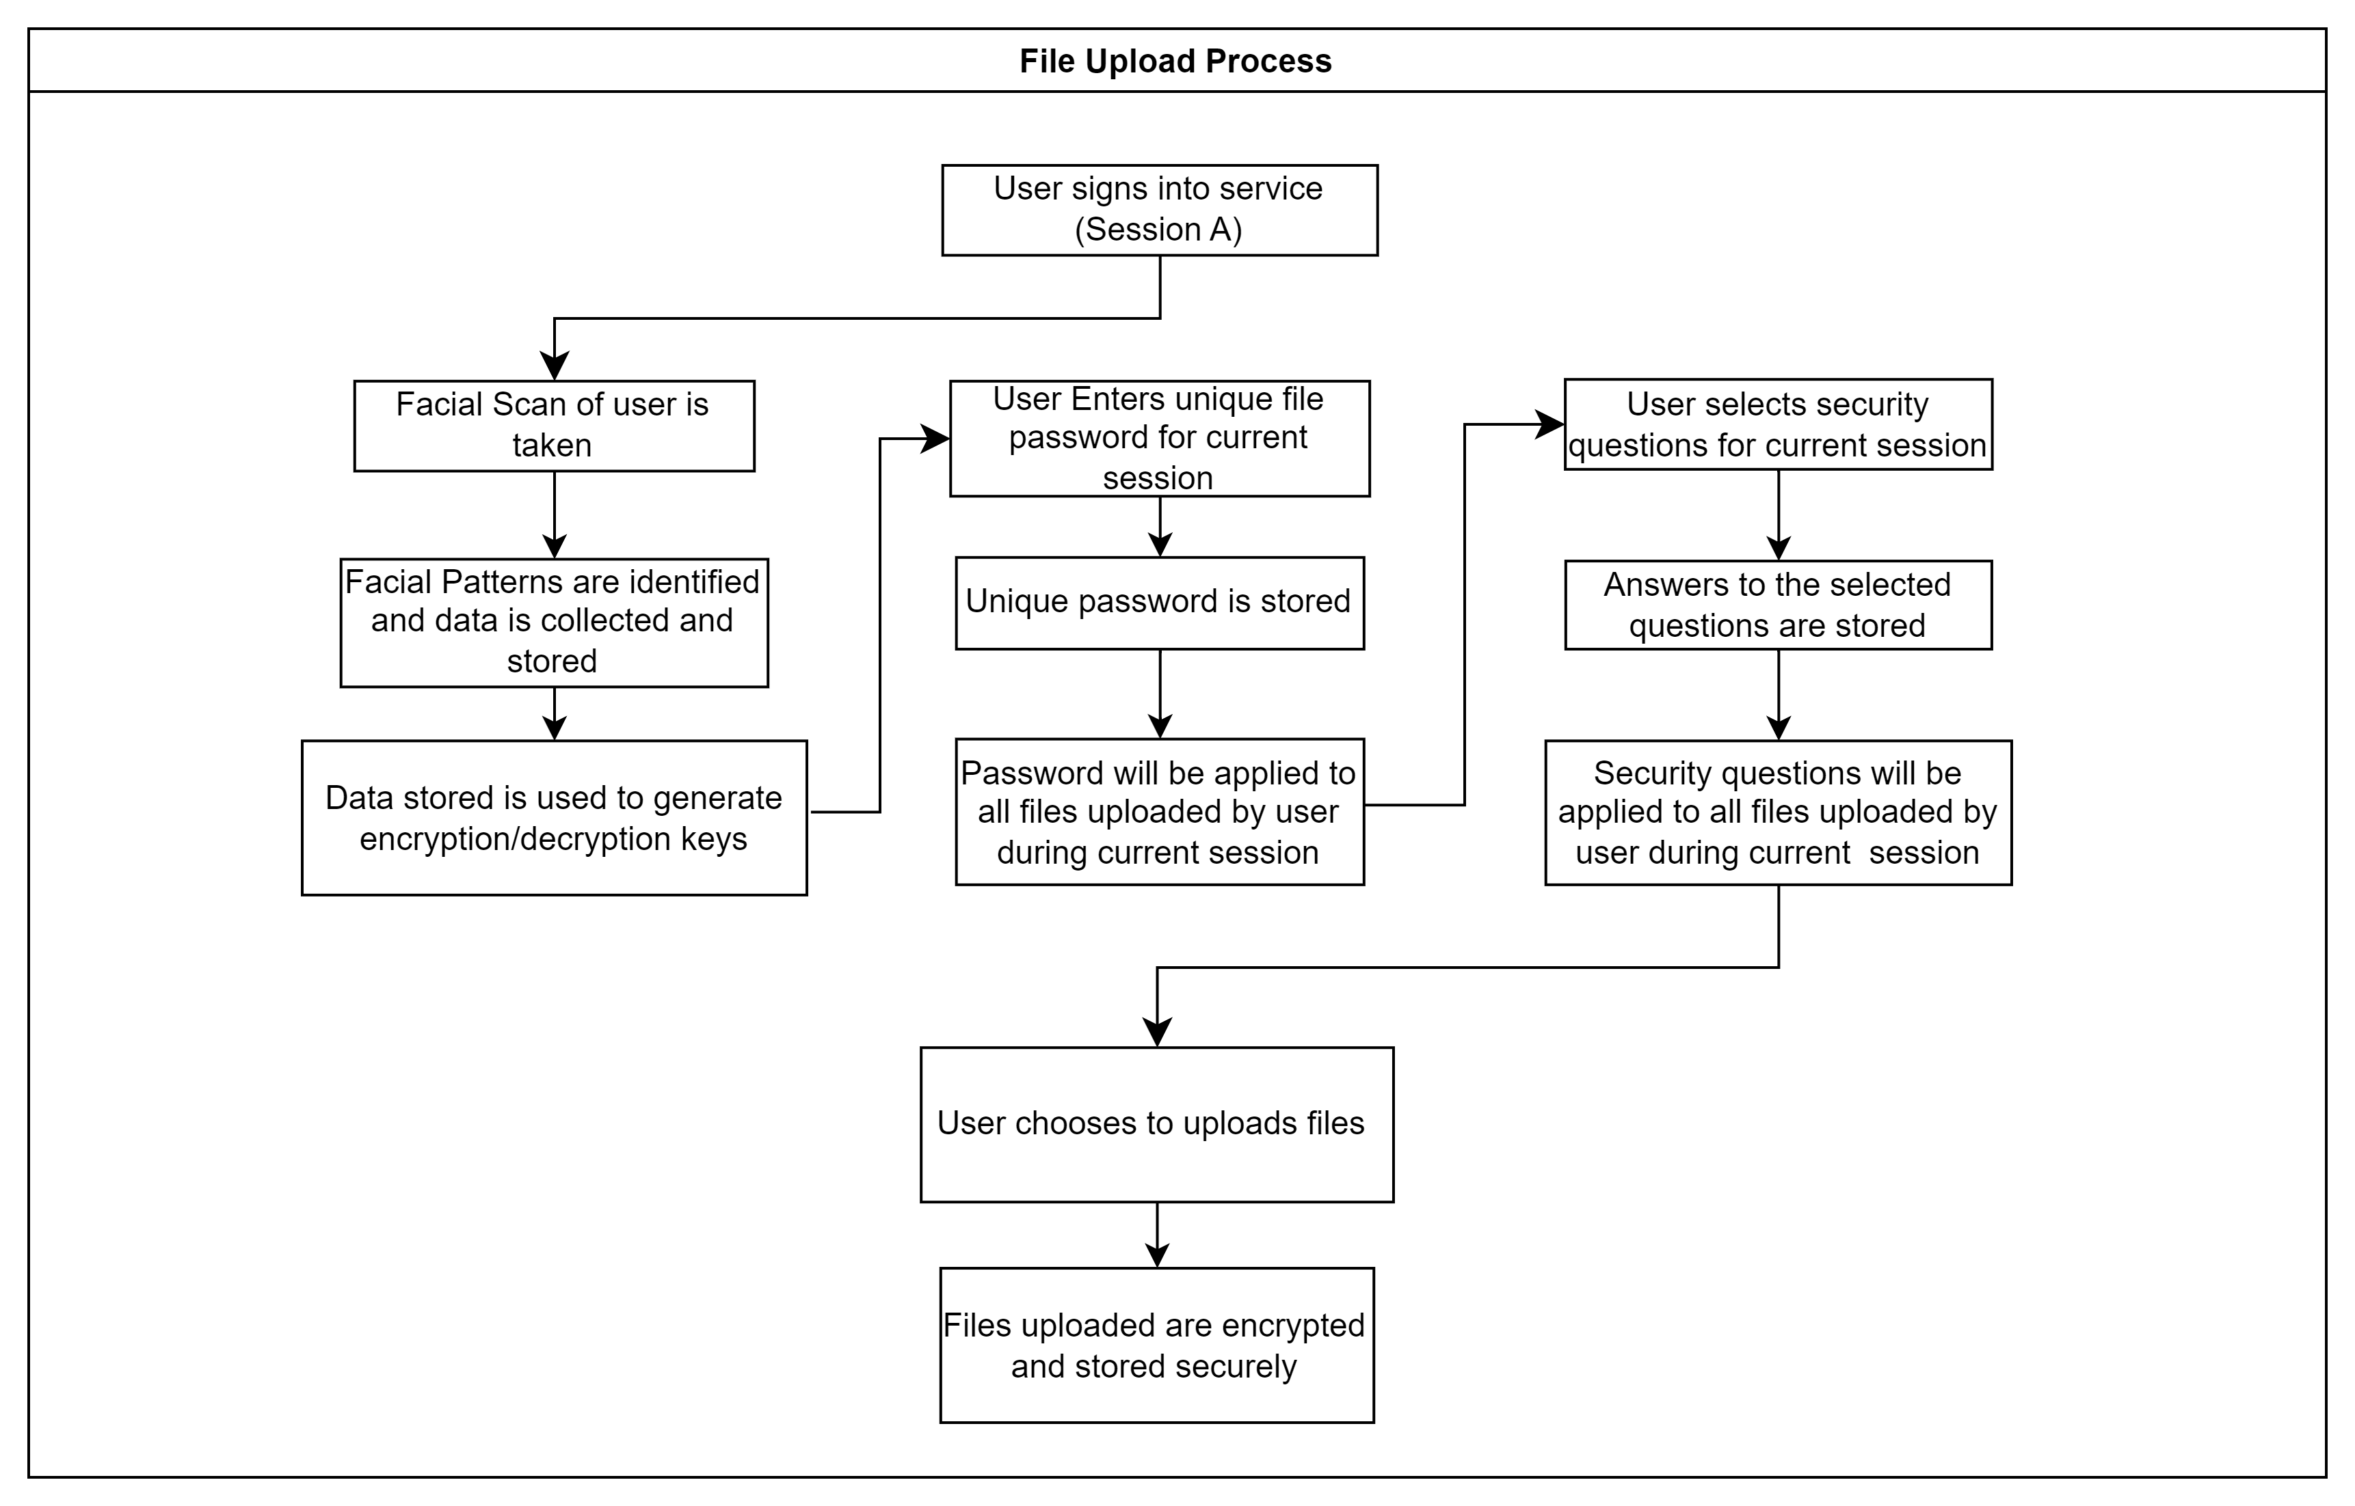
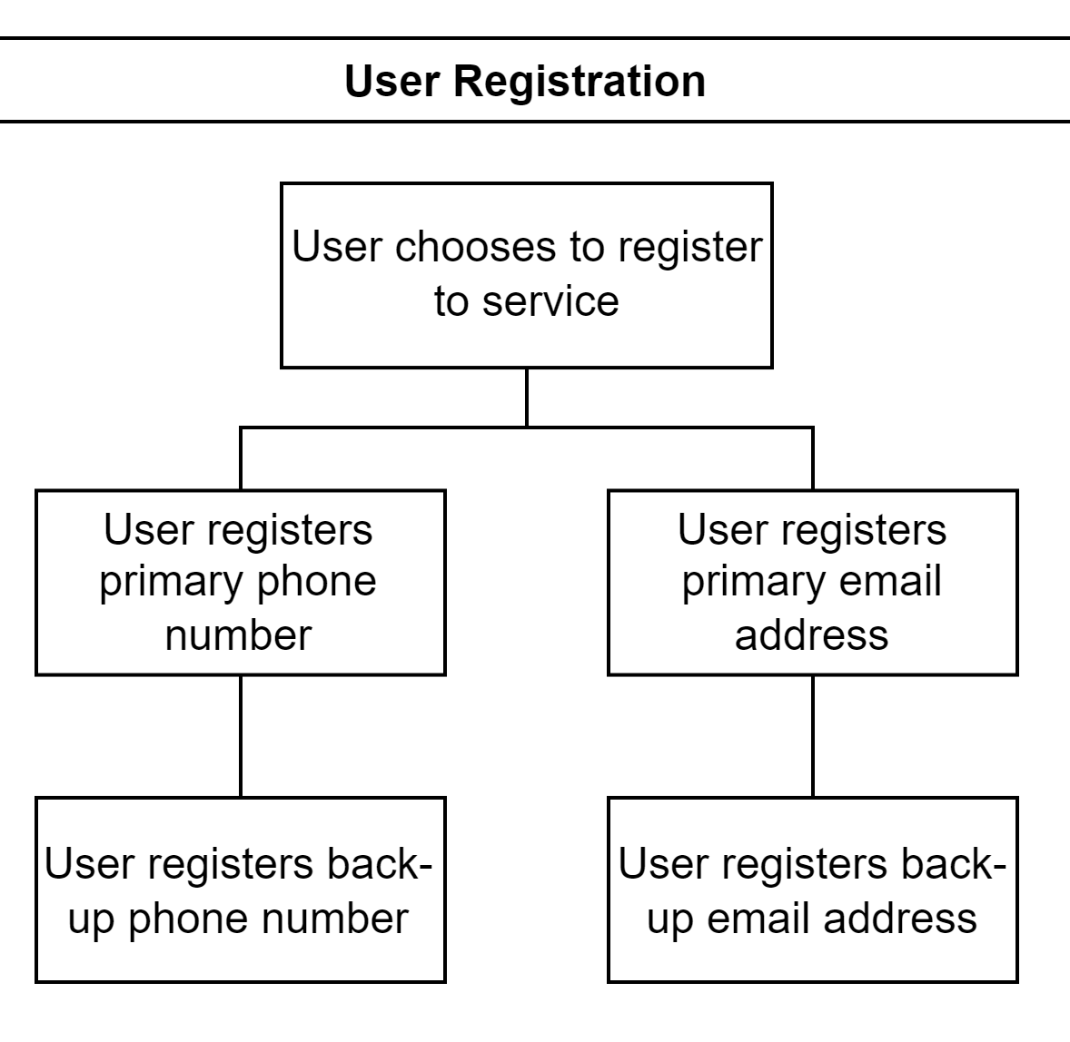
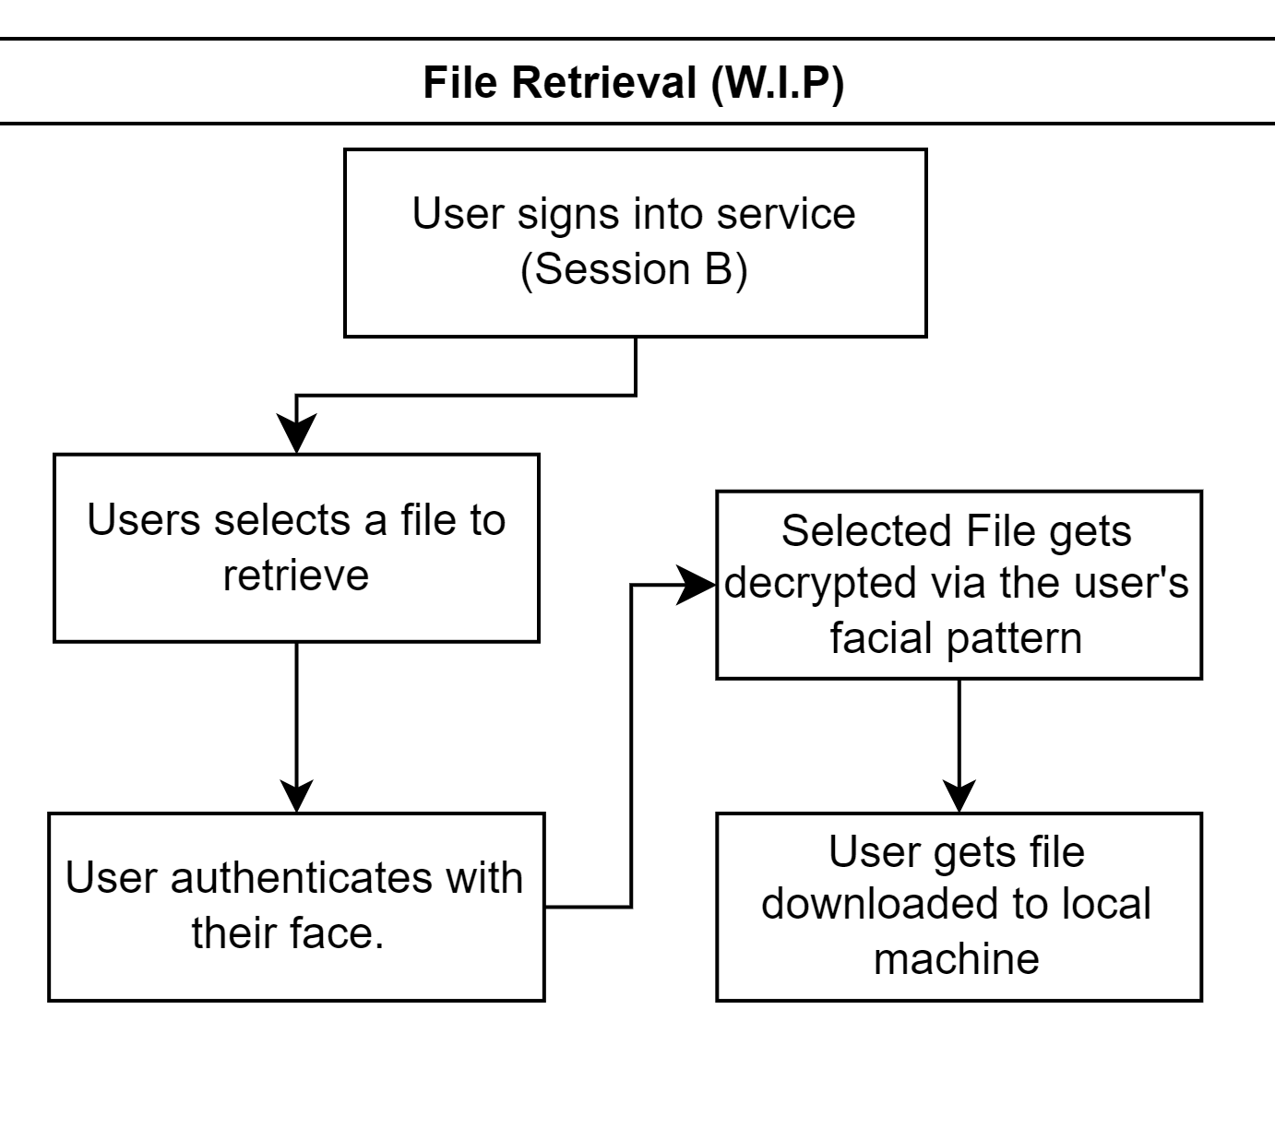
Flow of Project

Slide 7
Hosting
We will be hosting our webservice through Digital Ocean
Our service will be running off of Ubuntu-Linux version 22.04 LTS(Long Term Support) for our development
We were going to originally host our service off a computer with Ubuntu installed on it, of which we would then SSH into, but we ultimately decided to stick with Digital Ocean so that we can access and work on it from anywhere.
We will have daily scheduled backups

Slide 8
Conclusion
File storage alone can generally be disregarded by people but with technology constantly advancing and data being digitalized we need to ensure that the information that we store is properly maintained with security and privacy in mind.

