Slide 1

Project Required Resources & Project Environment
Justin Alejo, Marvin Estrada, Adam Ilarde, Raul Velasco

Slide 2



Hosting Services/IDE’s
Artemis
Kernel Version 5.10.0-23-amd64
Debian-based Linux system
Visual Studio Code
Used for development on web interfaces
Able to connect to ssh-based servers
MariaDB
Open-source relational database
Will be used to store our multimedia and other related data

Slide 3
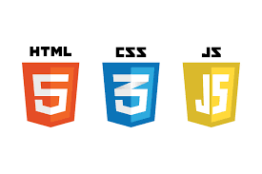



Languages
HTML (Interface)
Javascript (Interface)
CSS (Interface)
SQL (Database)
React.JS (Backend communication)
PHP (executing SQL queries)

Slide 4
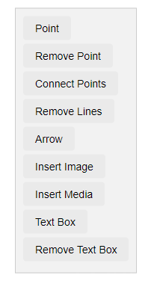
Front-End Progress: Toolbar
Toolbar Link:
https://www.cs.csub.edu/~ailarde/seniorProj/test.html
Point: Adds a marker on the map.
Remove Point: Deletes a selected marker.
Connect Points: Draws lines between markers.
Remove Lines: Erases selected lines.
Arrow: Inserts an arrow graphic.
Insert Image: Adds an image to the slide.
Insert Media: Embeds video or audio.
Text Box: Creates an area for text.
Remove Text Box: Removes a text area

Slide 5
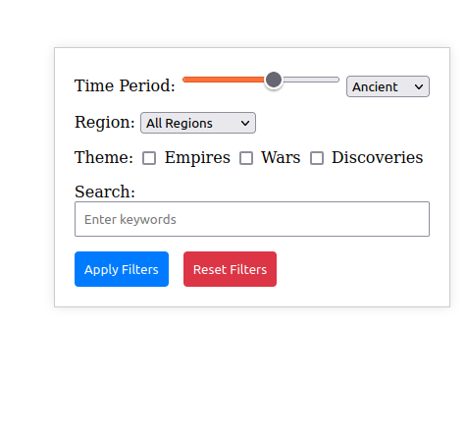
Front-End Progress: Filters
Link:
https://www.cs.csub.edu/~rvelasco/seniorProject/Test_filter.html
Region Filtering
Checkboxes for historic themes
Possible keyword search
Time period slide
Buttons apply/reset

Slide 6
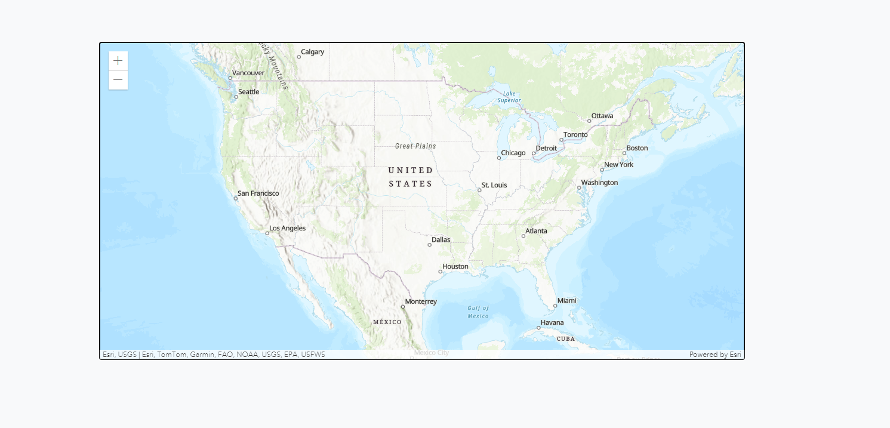
Front-End Progress: Map
Link:
https://artemis.cs.csub.edu/~gistory/test.html
Created new API key
Dynamic Main Map
Can zoom in and out

Slide 7
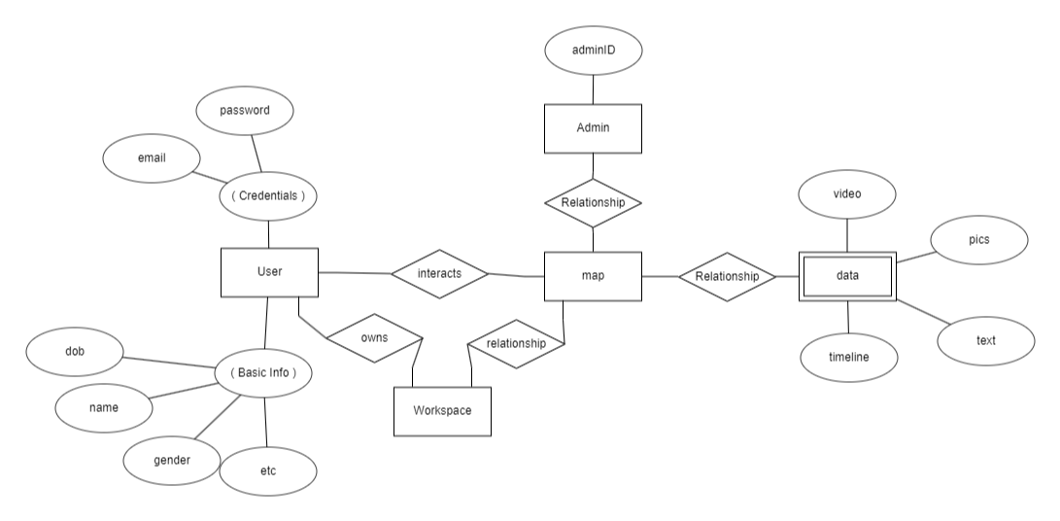
Back-End Progress: ER Diagram Rough Draft

Slide 8
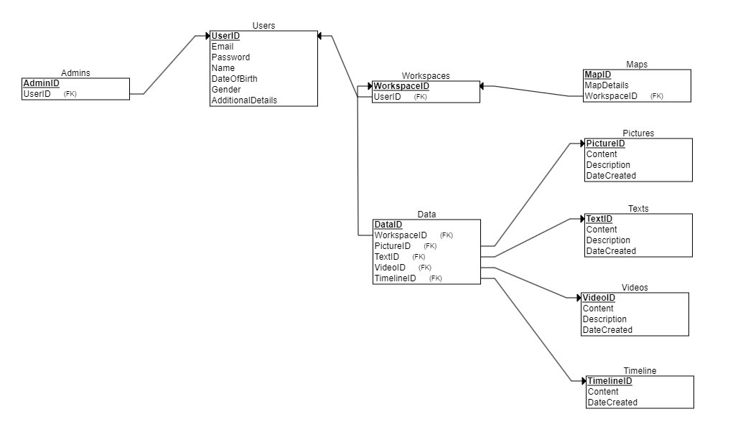
Back-End Progress: Relational Schema Rough Draft

Slide 9
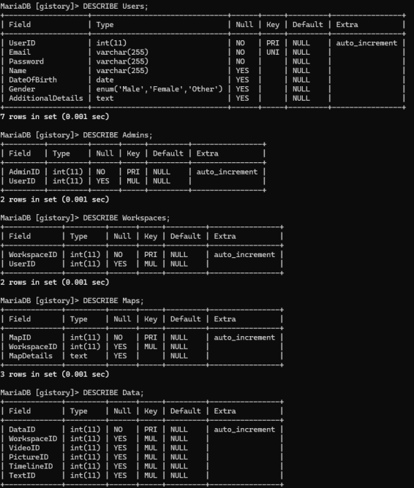
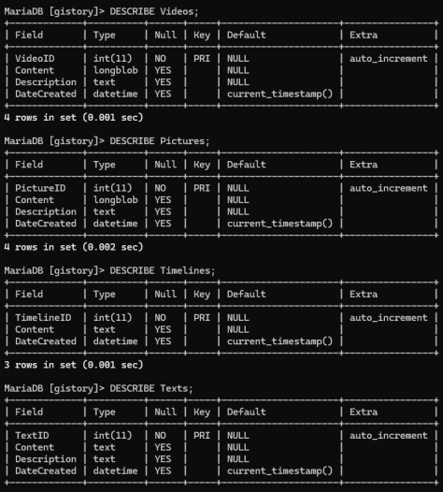
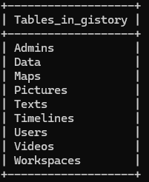
Back-End Progress: Creating Tables

