Slide 1
Progress Presentation
By; Joseph Rivera & Alia Al-Maitah

Slide 2
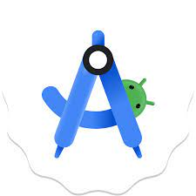
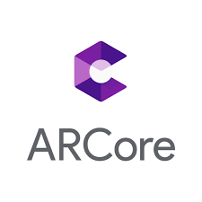
Android Studio, ARCore, and Unity

Slide 3
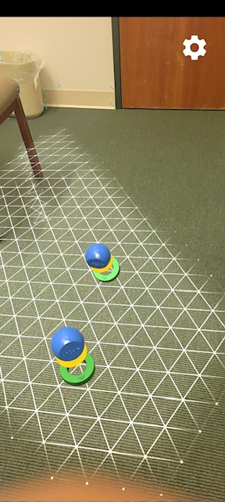
App Development
Developed a template application in Android Studio using Augmented Reality and Object Detection
Working on implementing Unity into our Android Studio template application
ARCore is used to help establish the necessary features needed for AR in Android Studio

Slide 4
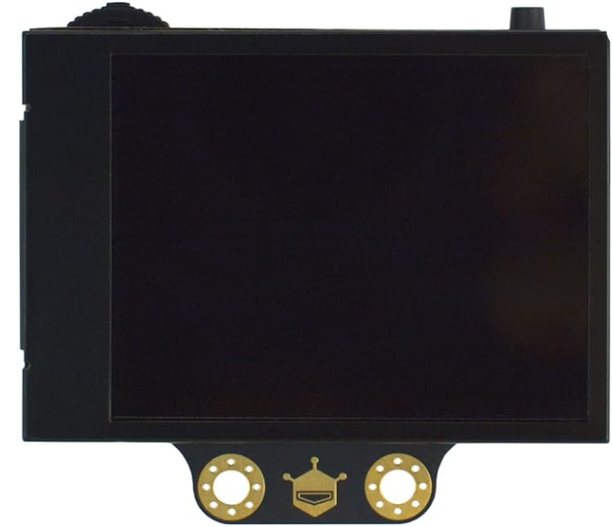
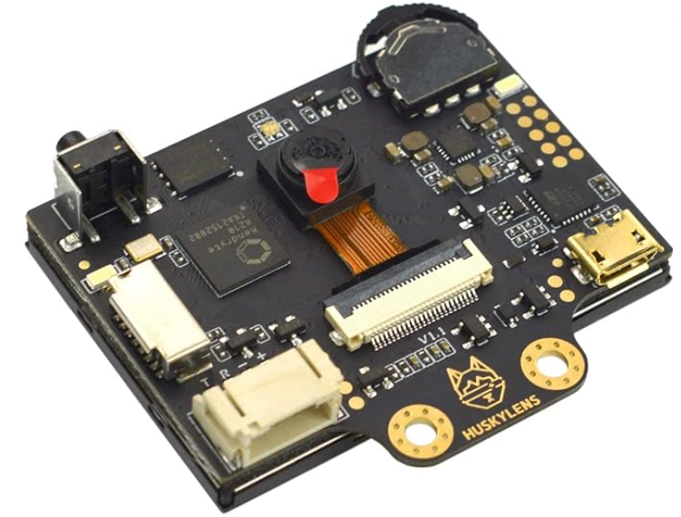
HuskyLens AI Camera
Object Detection & Tracking
Motion Detection
OnBoard Screen
Machine-Learning Enabled

