Slide 1
Project Progress
Justin Alejo, Marvin Kojima Estrada, Adam Miyazaki Ilarde, Raul Nintendo Velasco

Slide 2
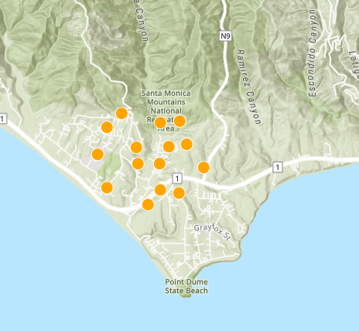
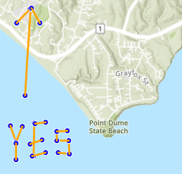
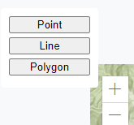
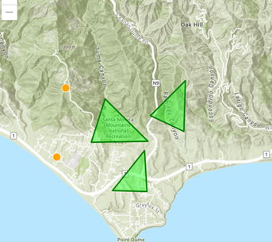
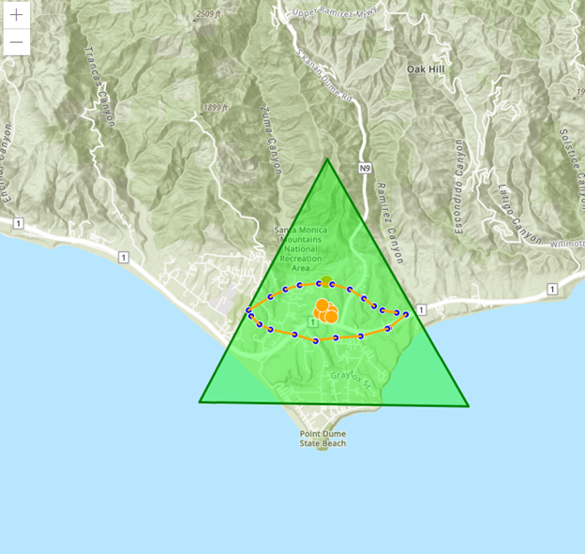
Map features
Features for now
Added 3 geometry features
Can place them anywhere on the map
User can switch between any one of the 3
Things to implement later
Change color
Make polygons more dynamic
Store feature data in database
Have each point popup a subwindow

Slide 3
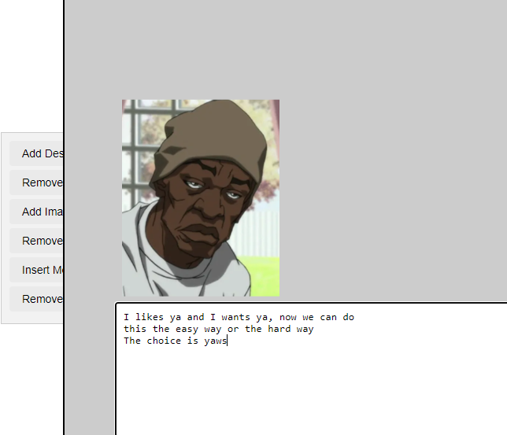
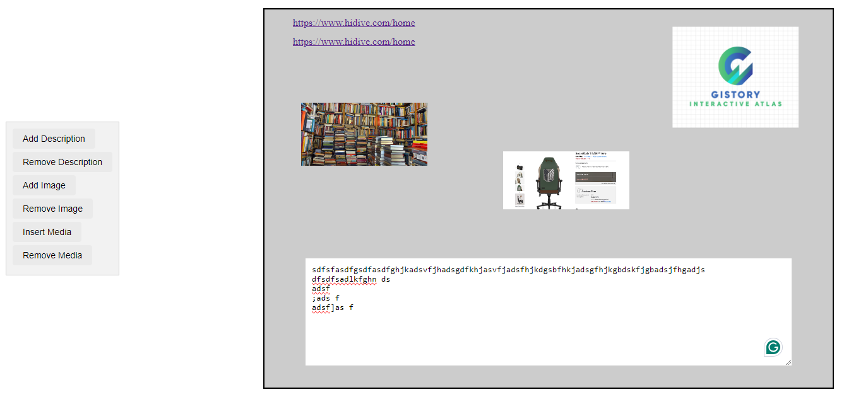
Subwindow/Toolbar
Functioning toolbar for subwindow
Insert Description
Remove Description
Add Image
Remove Image (Remove image last inserted)
Insert Media (Insert a link)
Remove Media (Remove the last link added)

Slide 4
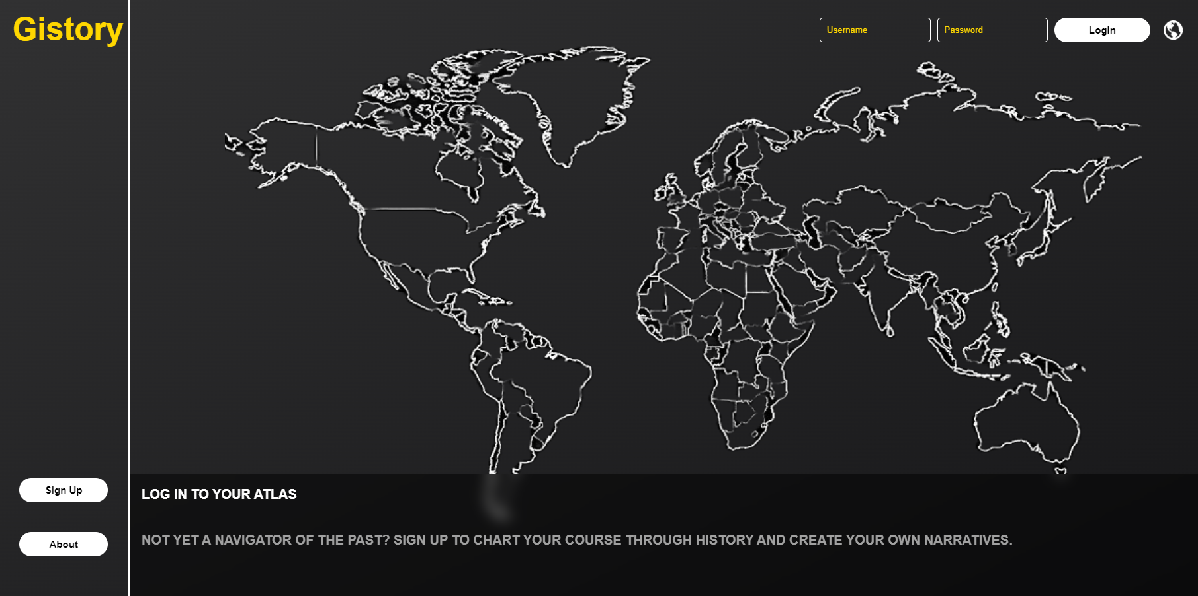
Login Page & Configuration
Frontend: login.html
Contains the structure of login page
Frontend: style.css
Contains visual styling
Frontend: script.js
Interactivity and button redirection
Backend : config.php
Contains global settings and database configurations

Slide 5
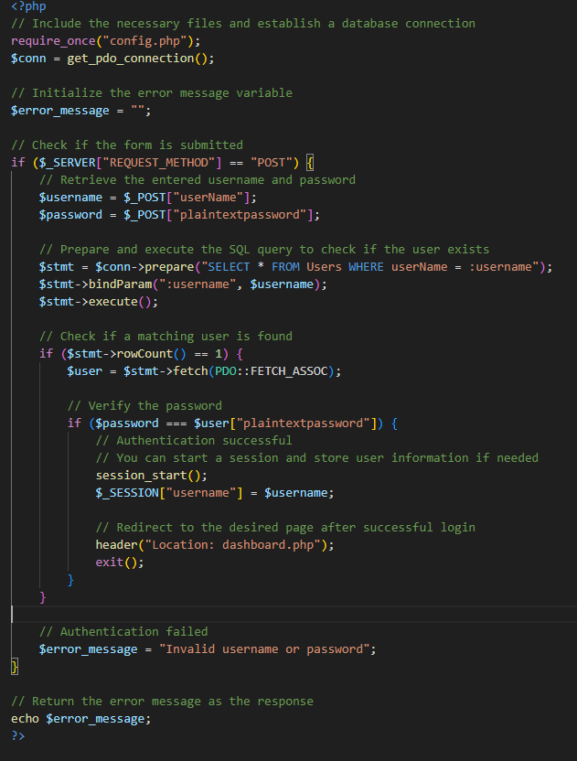
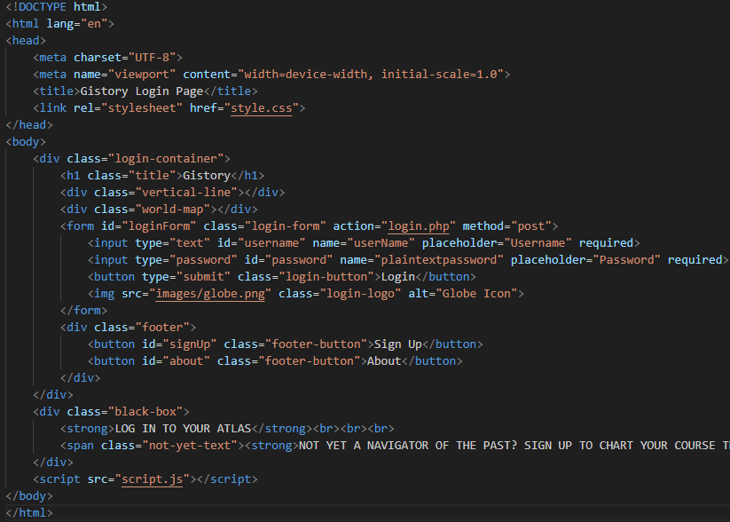
Login Functionality
Login Functionality
Backend: login_process.php
Validates user credentials against the database and manages the particular session
Frontend: login.html
Structure and content for the login container

Slide 6
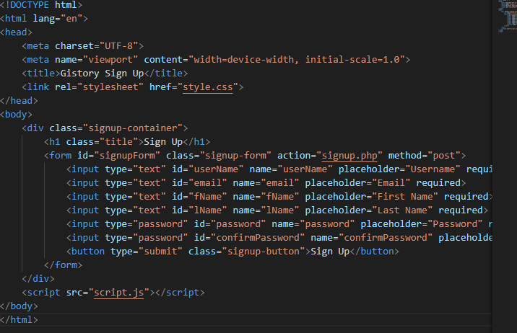
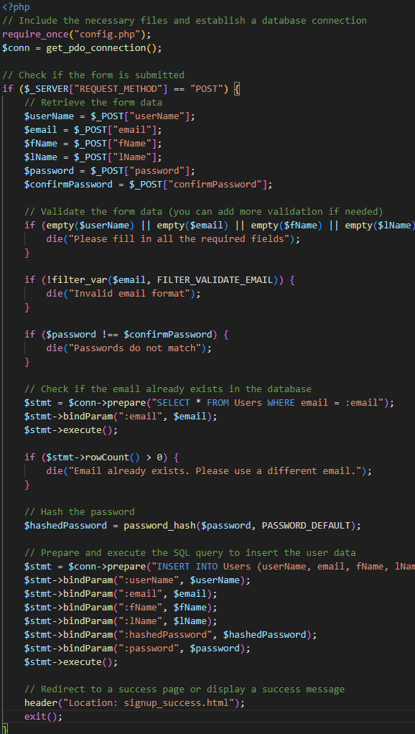
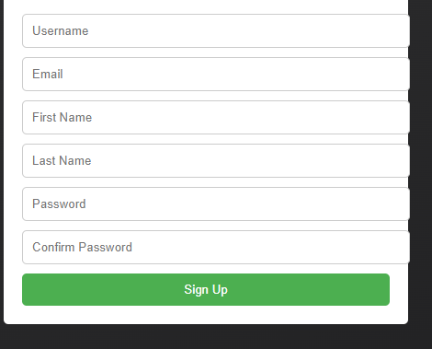
Sign Up Page
Sign Up Process and Design
Backend: signup_process.php
Manages user sign-up and database tasks
Frontend: signup.html
User sign-up form with “Sign Up” button
Frontend: signup_success.html
Confirmation message post-registration

Slide 7
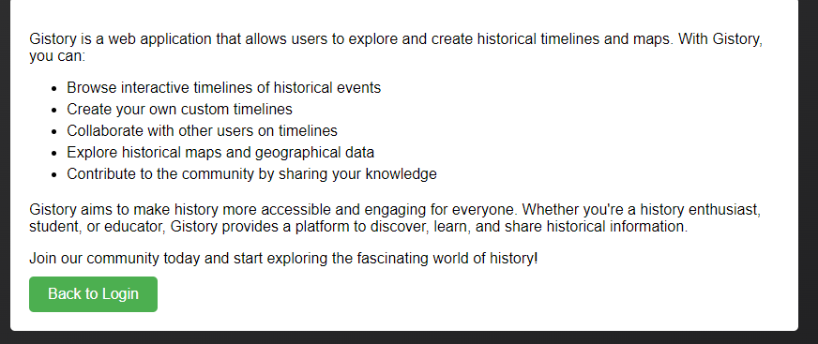
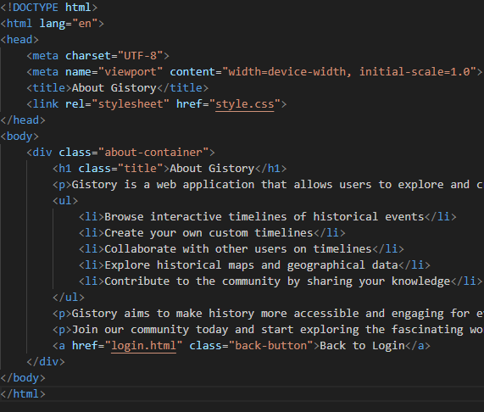
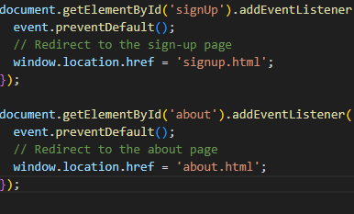
About Page
Designed a basic layout for About page
Page provides information on the project's goals.
Frontend: about.html
Structure and content for the “About” page
Frontend: script.js
Event listeners redirecting to ‘about.html’

Slide 8
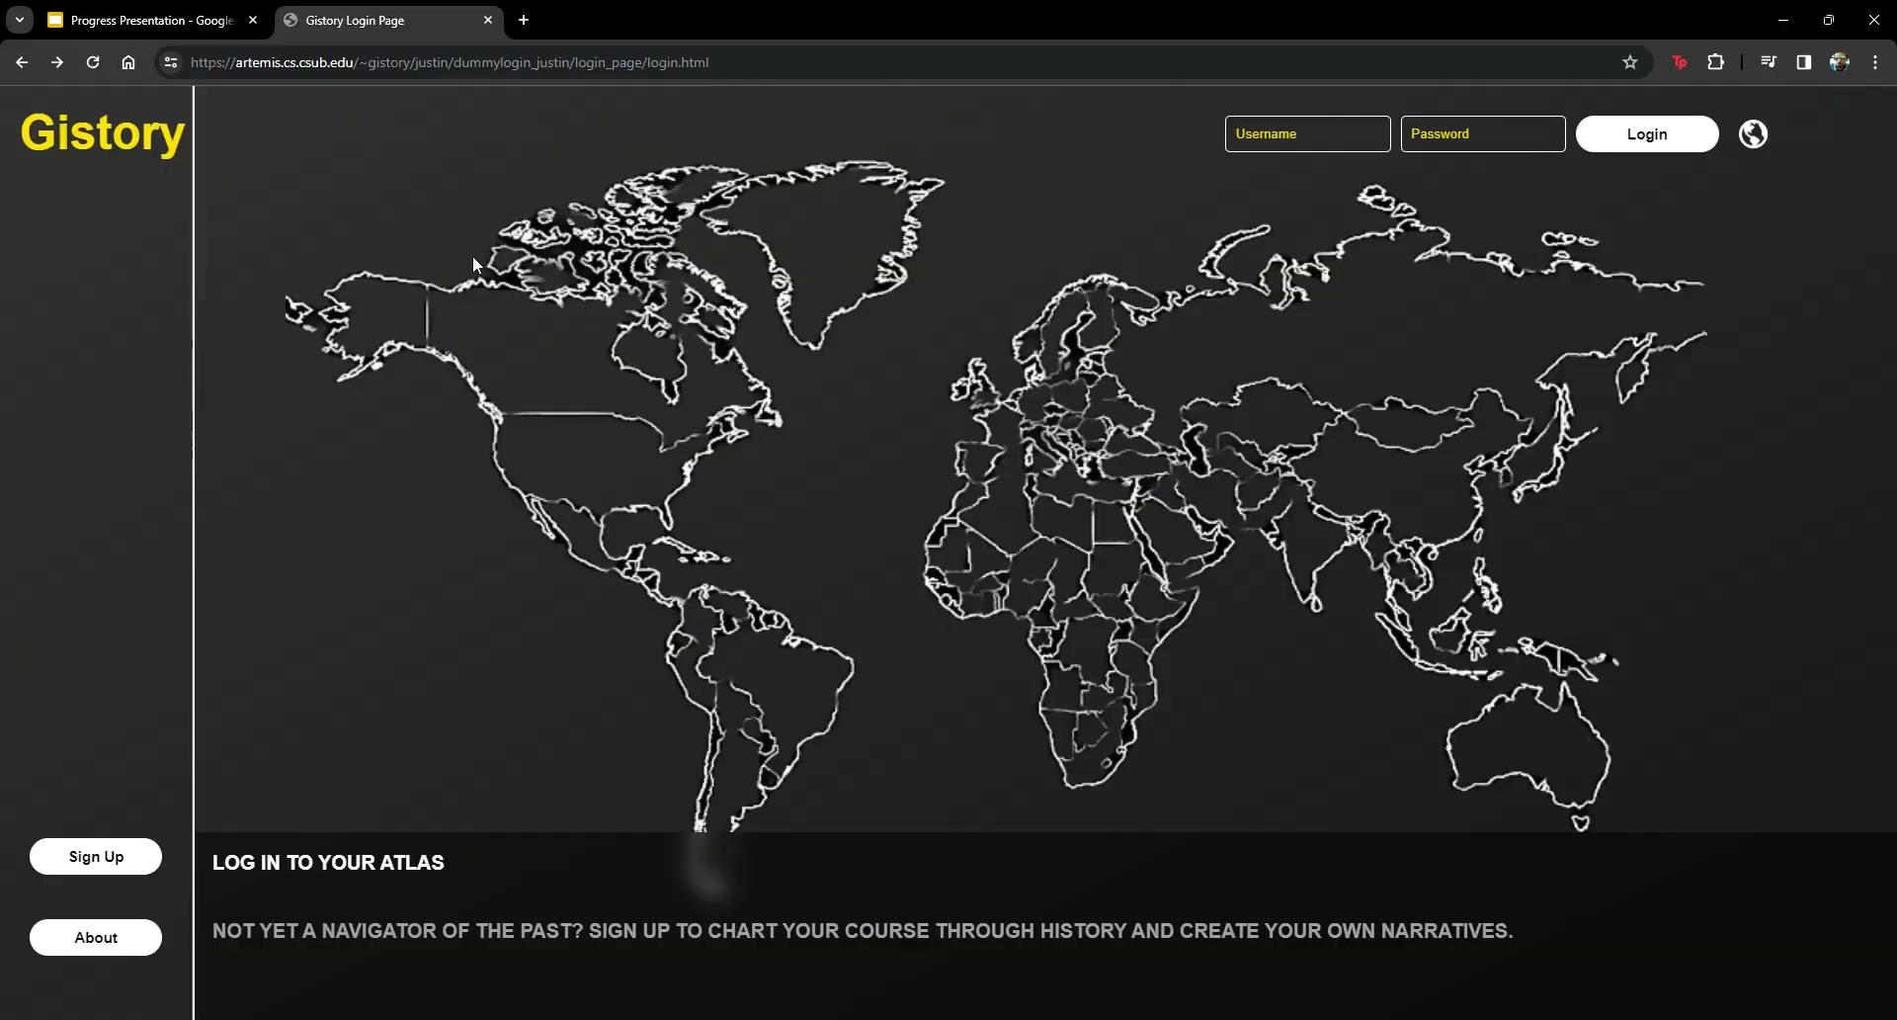

Slide 9
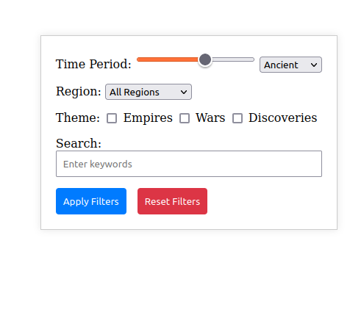
Year timeline
Had to be scaled down
Focus just on the year currently displayed
Horizontal timeline with interactive years
Expand filter later on
Focused improving horizontal timeline

