Slide 1
Progress Presentation
Aaron, Nathan, Gustavo, Jesse, Alejandra

Slide 2
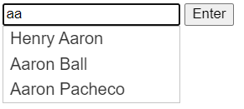

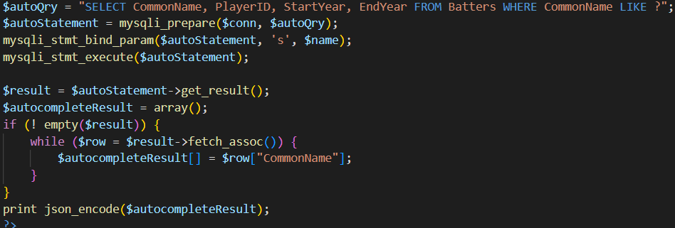
Autocomplete function searches database with at least 2 characters for names including those characters and displays them in a dropdown field

Slide 3
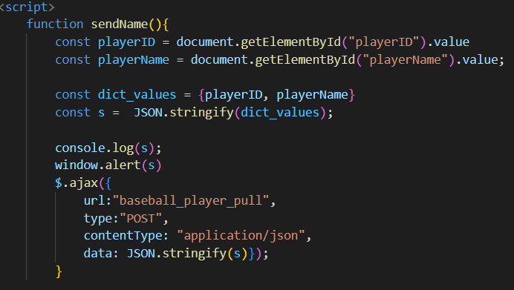
Once the user has submitted a name, the website will call the web scraper script

Slide 4
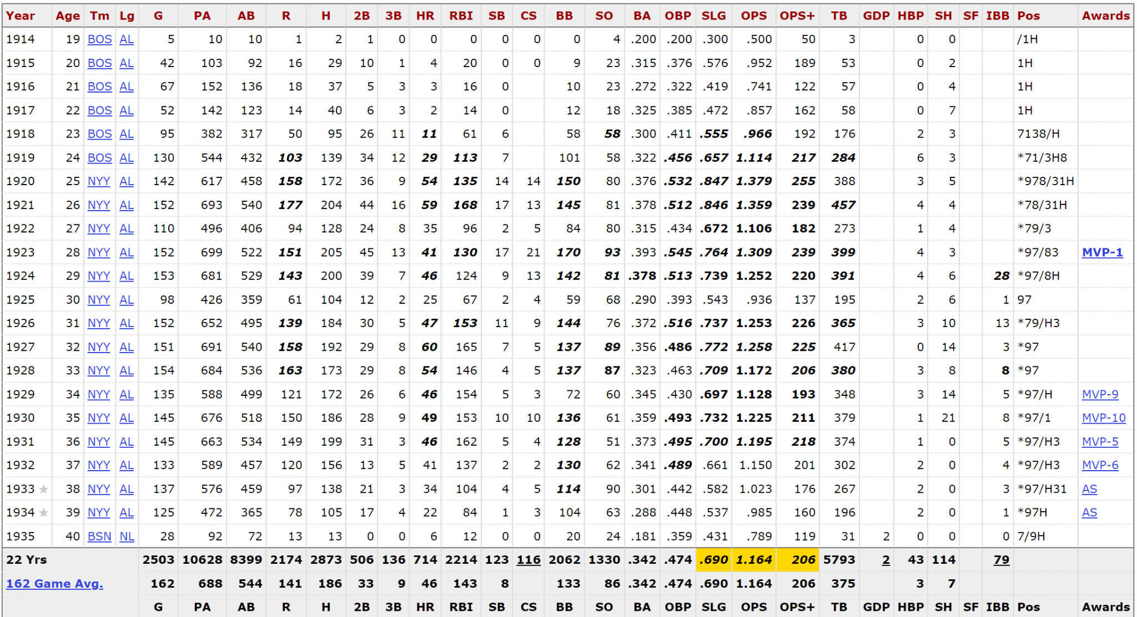
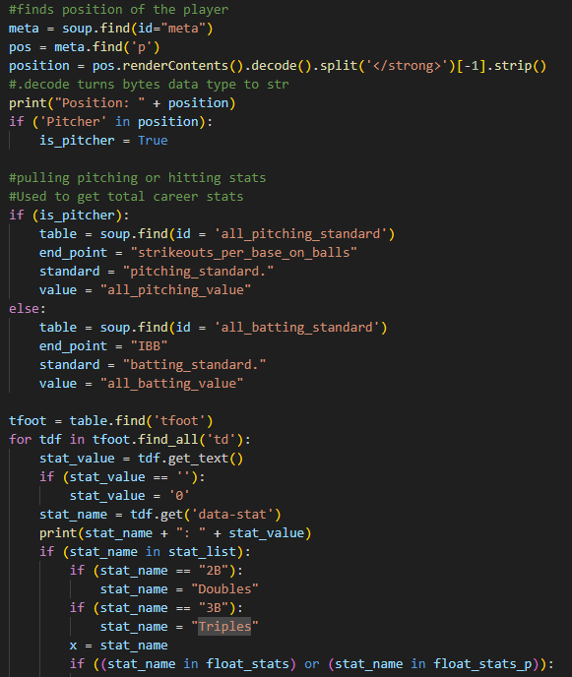
Nathan
Code to parse through baseballreference.com to find requested player’s stats
Sends an SQL UPDATE to enter player’s stats into table

Slide 5
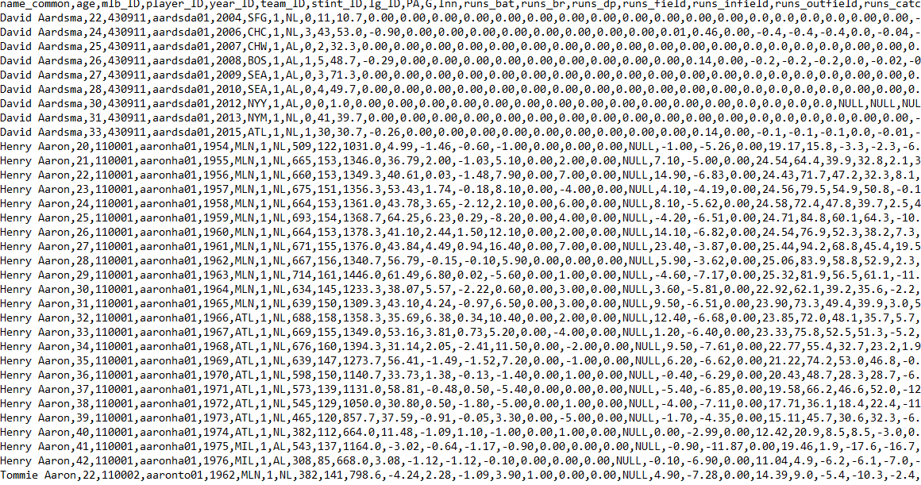
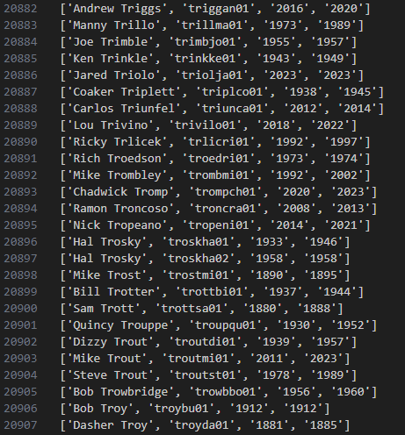
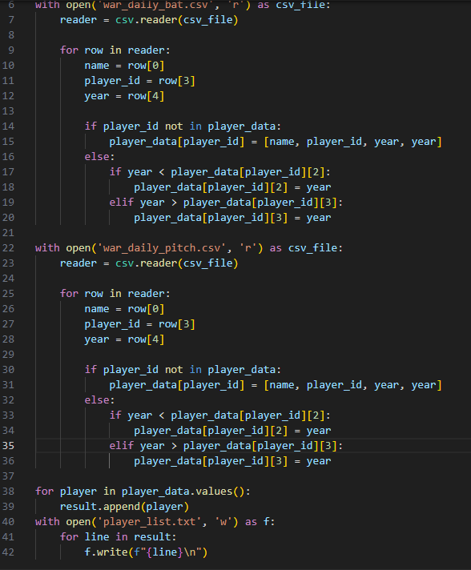
List of every MLB player ever with their unique ID, year of debut, and last year played used to create database

Slide 6
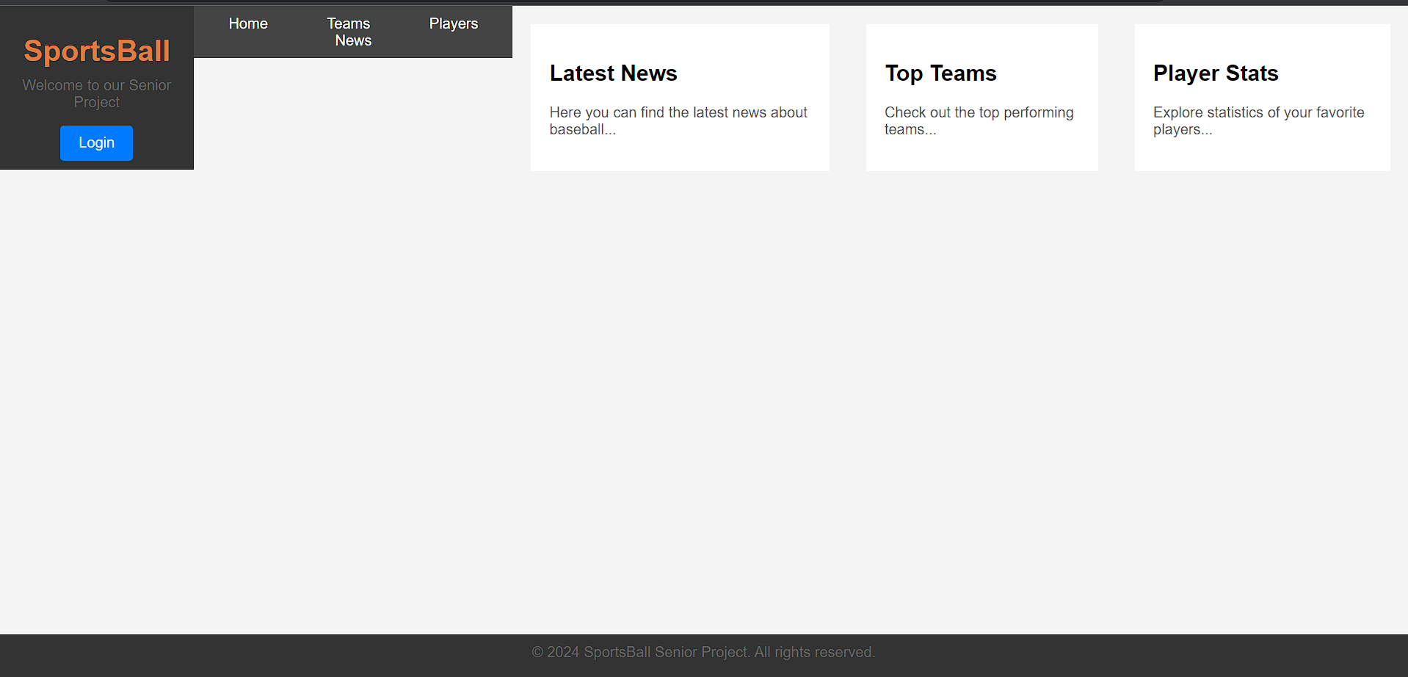
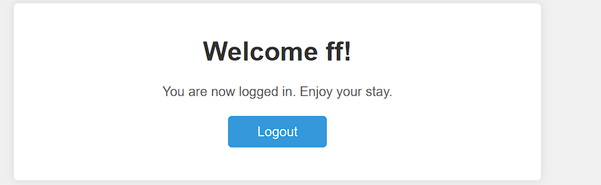

Slide 7
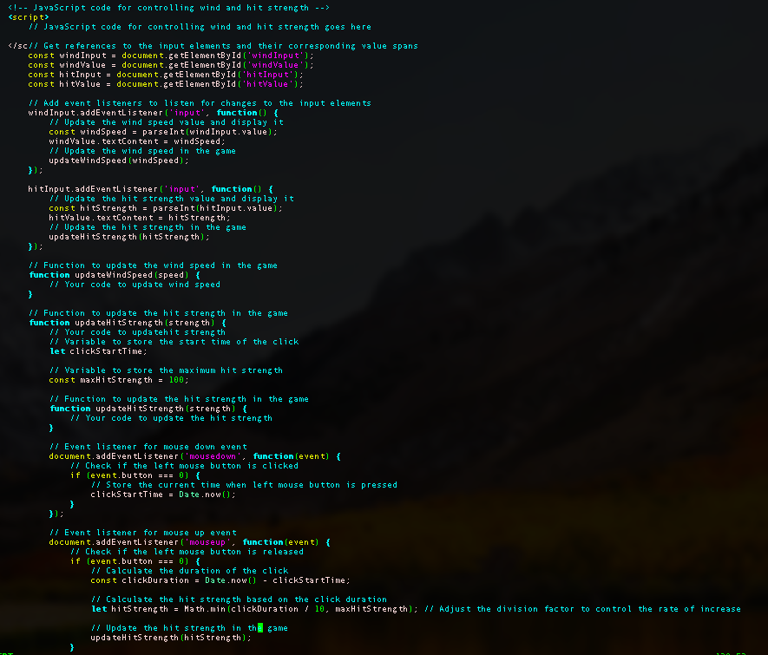
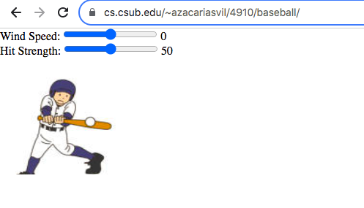
2D Game Engine
Simulates how wind speed affects
direction of the ball

Slide 8
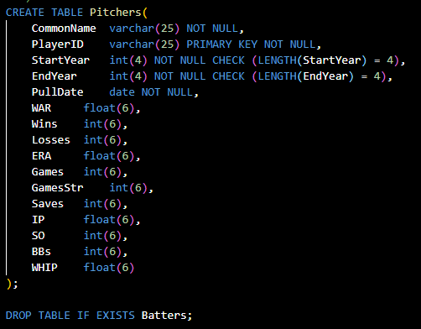
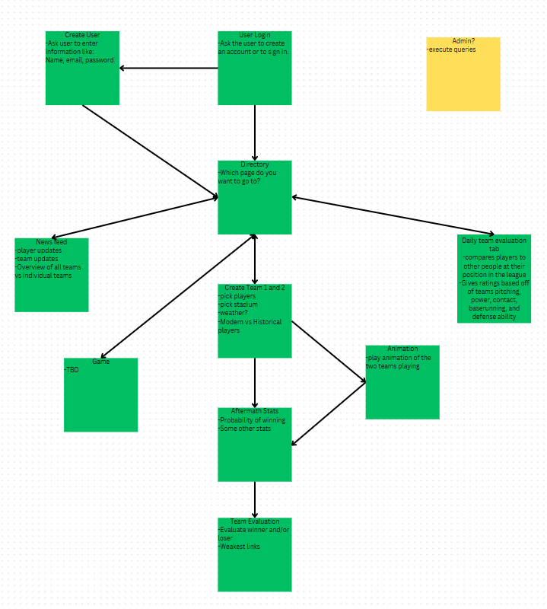
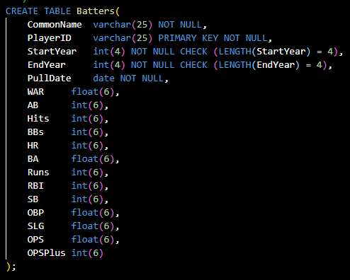
Database and Design
Ability to store data for baseball players
Show how a user may navigate through our website and the pages/features they may access

