Slide 1

UltravisionAR
Project Progress Report Presentation

Slide 2
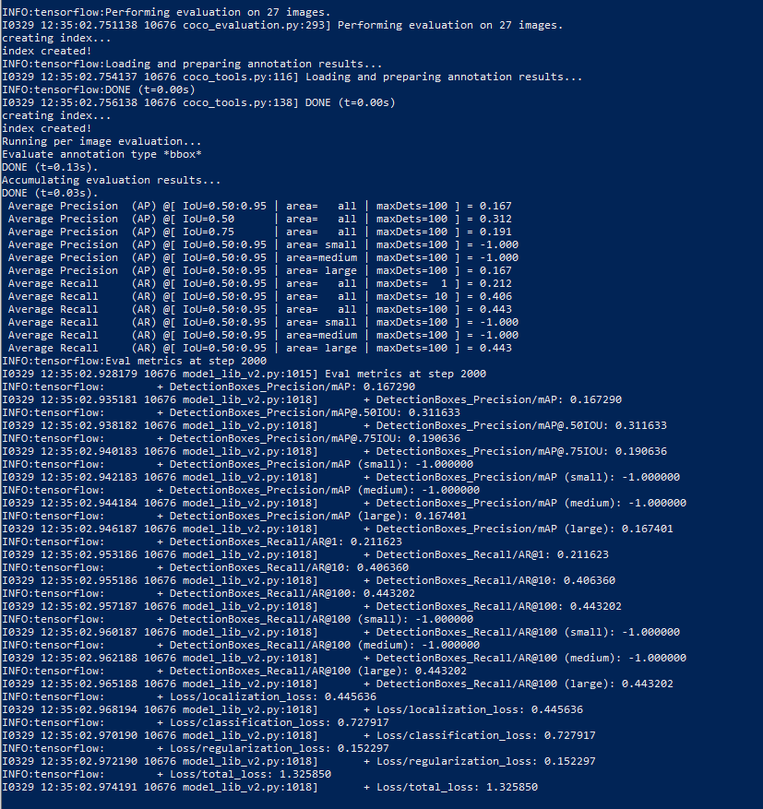
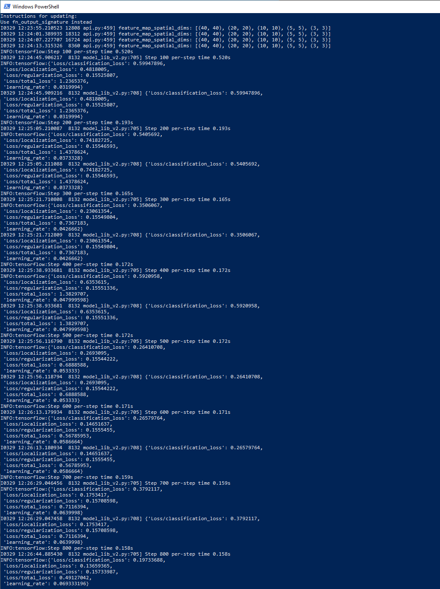

Slide 3
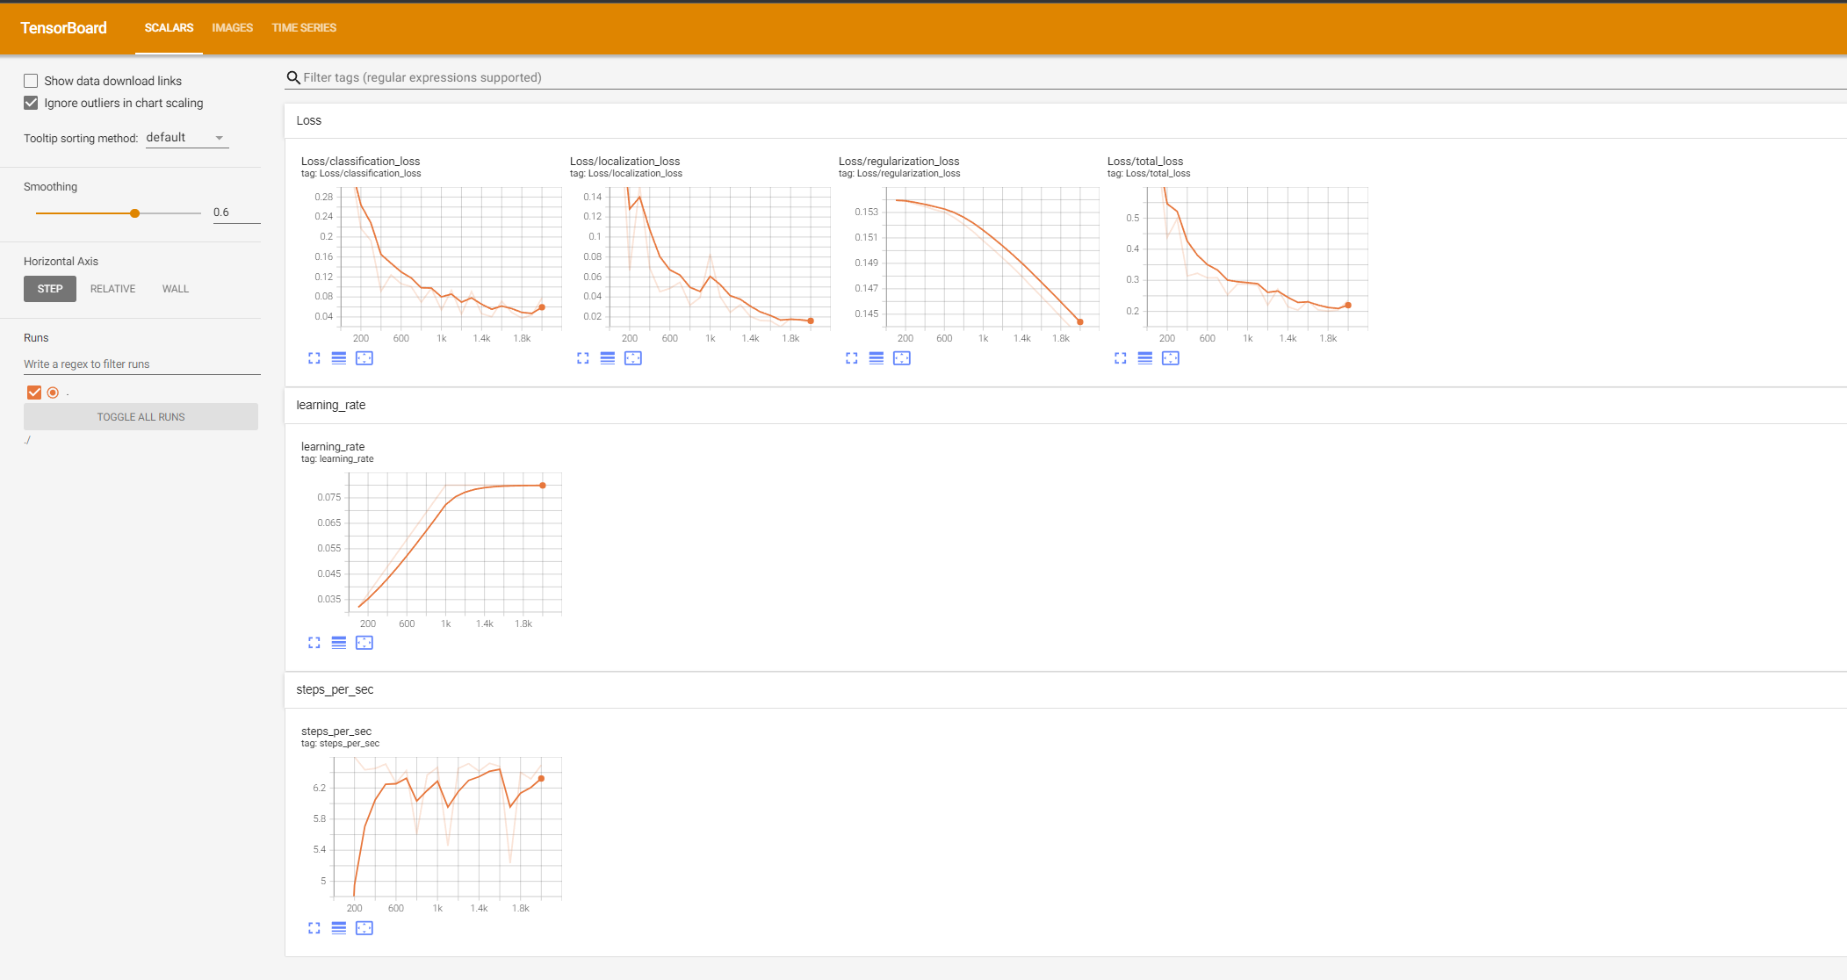
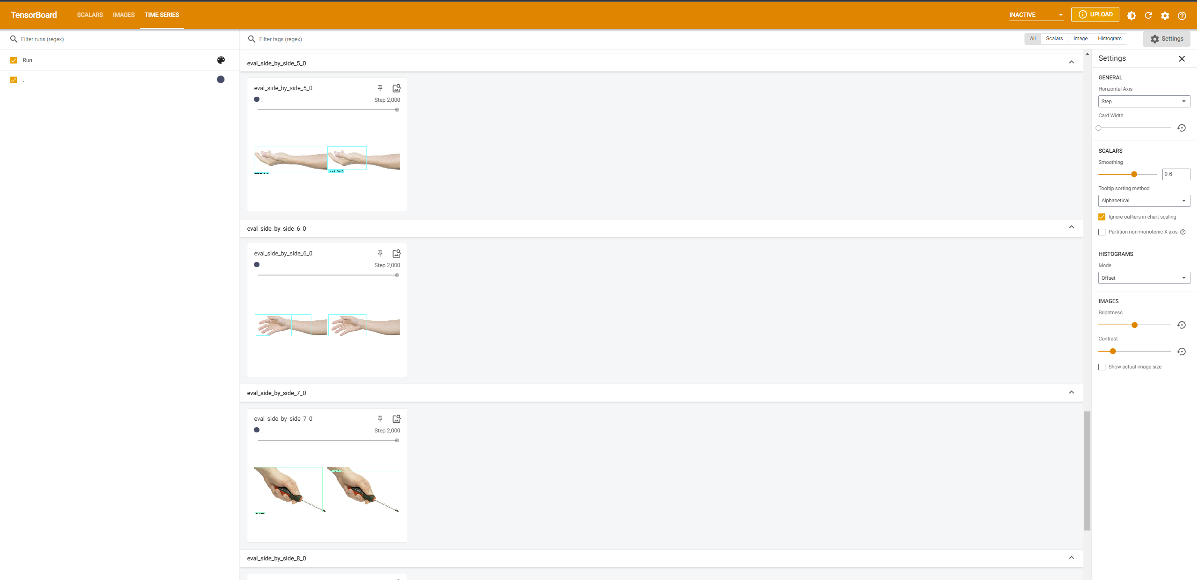

Slide 4
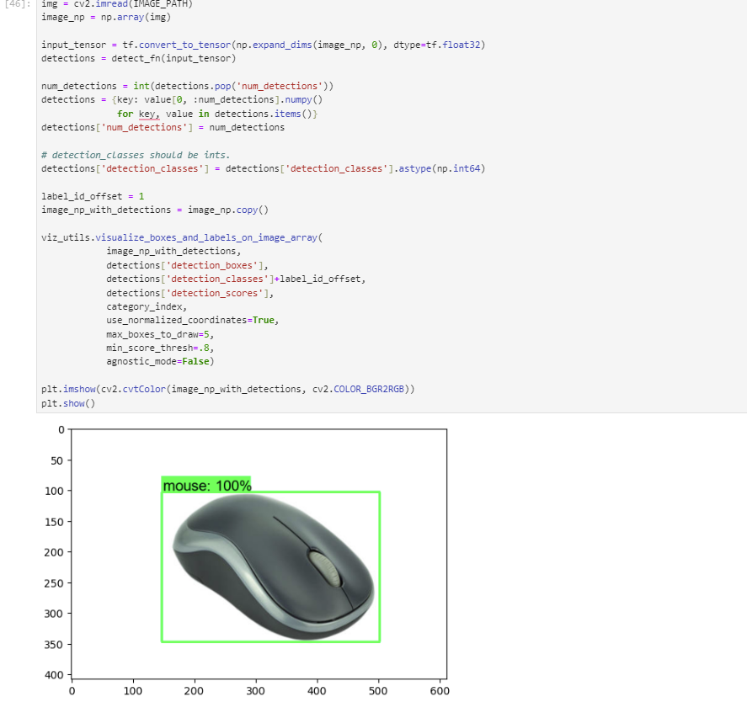
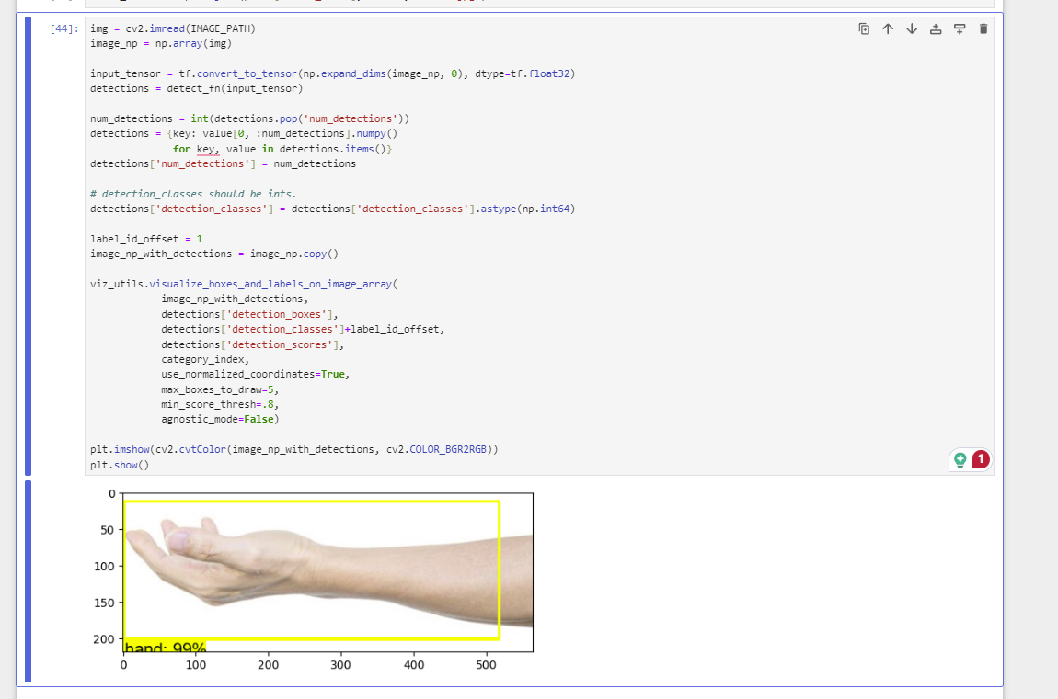

Slide 5
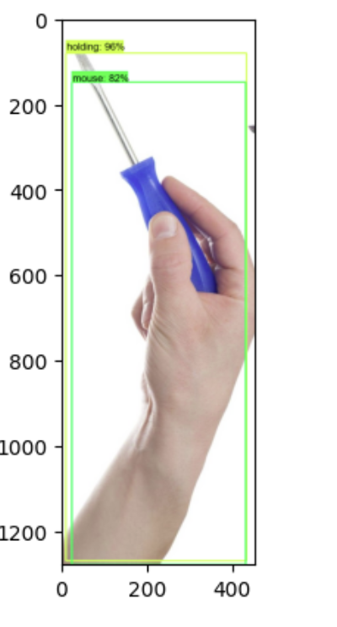
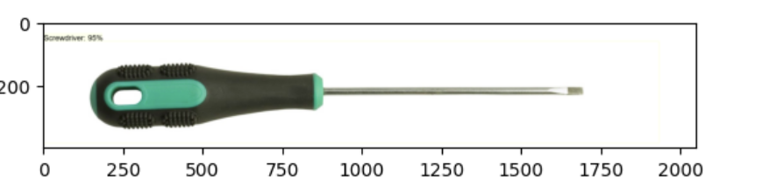

Slide 6
Reference
https://github.com/nicknochnack/TFODCourse
https://www.tensorflow.org/install/source_windows#tested_build_configurations
https://www.tensorflow.org/lite/examples/object_detection/overview

