Slide 1
GIStory Final Presentation
Justin Alejo, Marvin Estrada,
adam ilarde, raul velasco

Slide 2
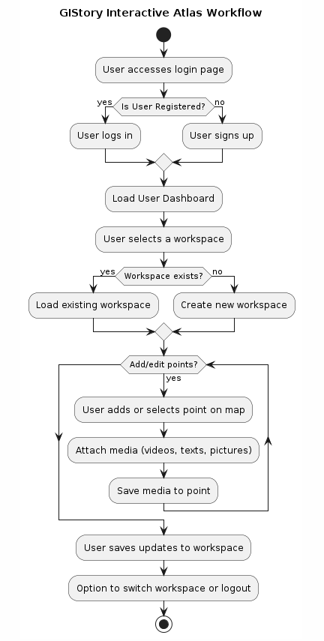
Flow chart
User Login/Signup:
Access the login page.
Log in if registered; otherwise, sign up.
Workspace Management:
Load the user dashboard after logging in.
Select an existing workspace or create a new one.
Point and Media Management:
Add or select geographical points on the interactive map.
Attach media (videos, texts, pictures) to the selected points.
Save the media attached to each point.
Saving and Session Management:
Save updates made within the workspace.
Provide options to switch workspaces or log out of the application.

Slide 3
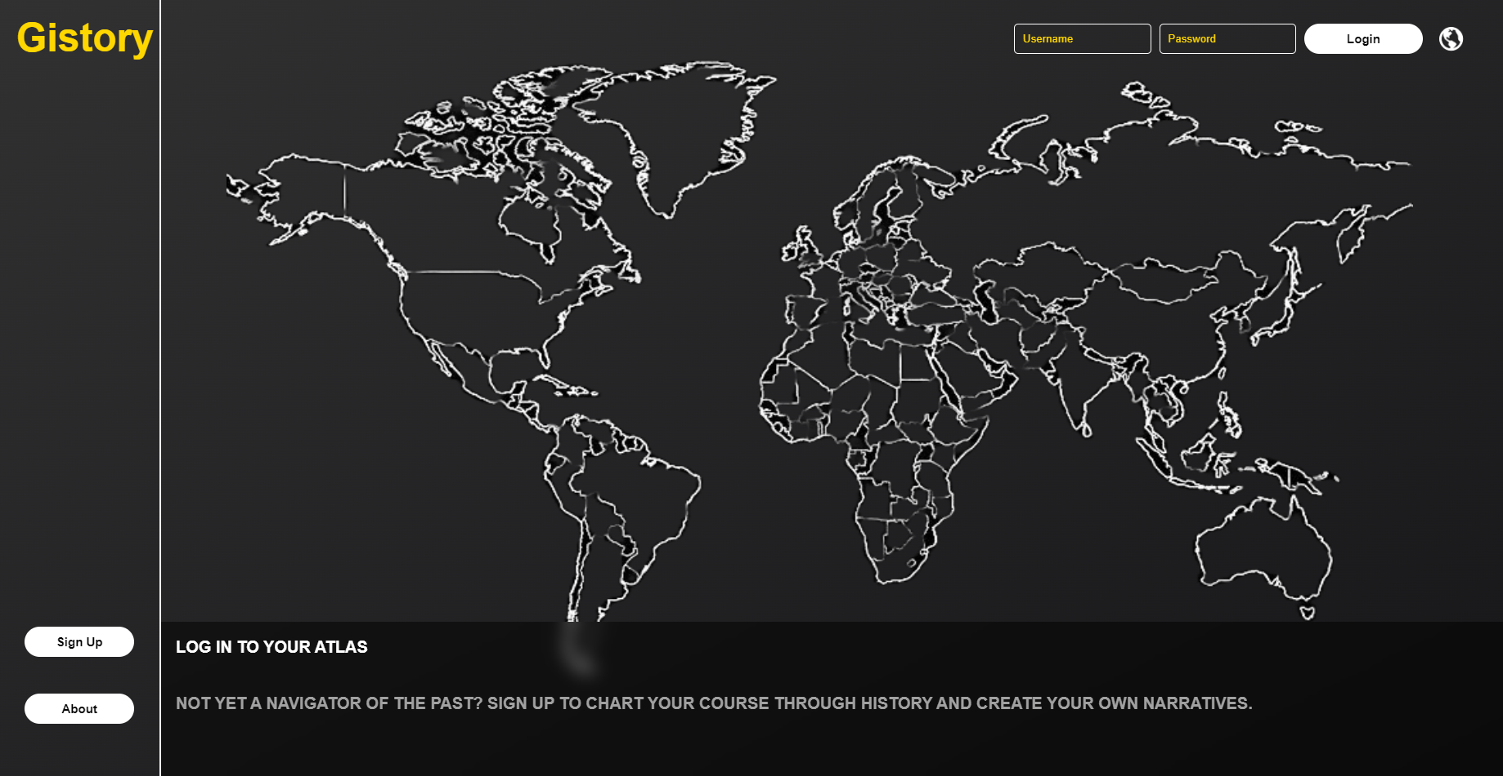
User Login/Signup

Slide 4
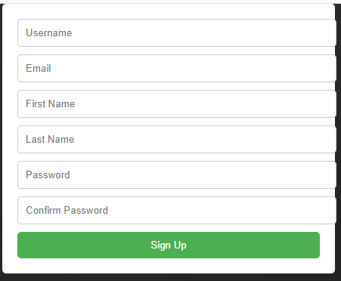
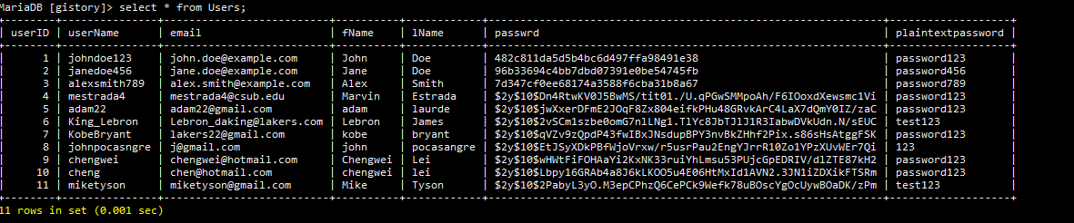
User Login/Signup

Slide 5
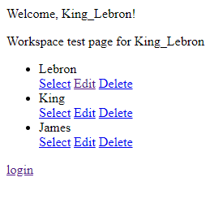
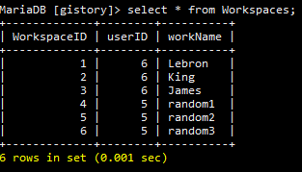
Workspace Management

Slide 6
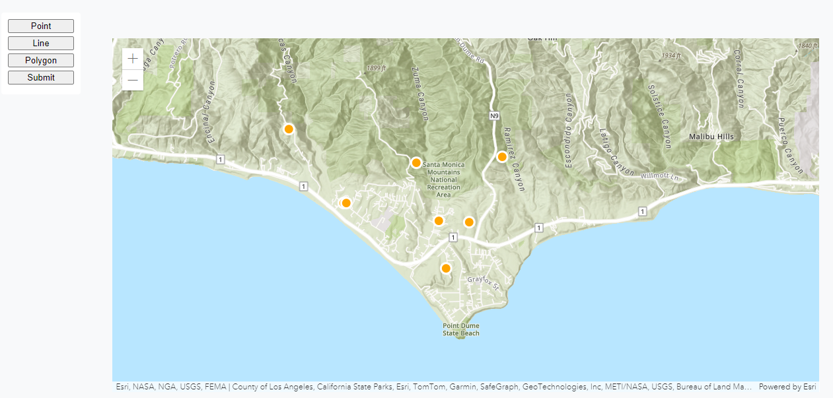
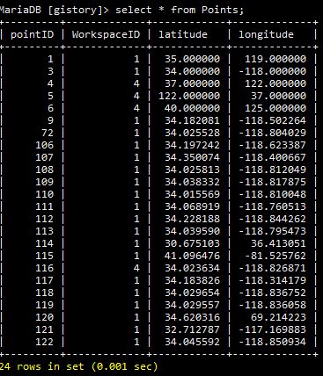
Points Management

Slide 7

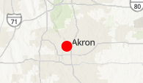
Media Management

Slide 8
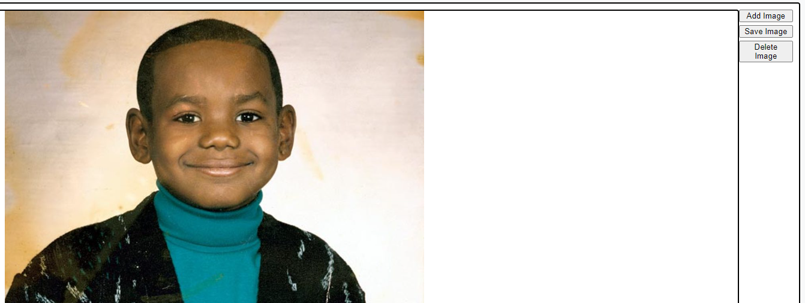
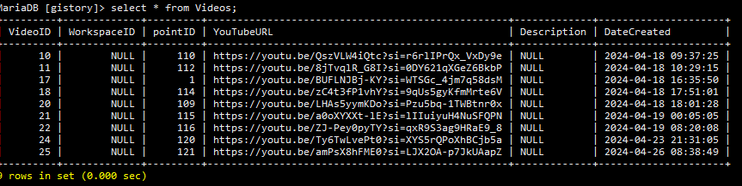
Media Management

Slide 9
Conclusion
What we accomplished:
Linked projects to Users
Linked points to projects
Linked media to points
All saved within the database
Login Page
About Page
Signup Page
What we still need to work on:
Have user be able to create project
Have more functionality with polygons and lines
More development on the frontend
More refining and customizations
etc
https://artemis.cs.csub.edu/~gistory/marvin/login_page4/edit_workspace2.php?id=1

