Slide 1
Sportsball Demonstration
Aaron, Nathan, Gustavo, Jesse, Alejandra

Slide 2
Overview
Pull data from a web source
Apply sabermetrics to data
Display data to the user through graphs and simulations
Users may create their own teams

Slide 3
Landing Page and Login
https://cs.csub.edu/~sportsball/project/main.php

Slide 4
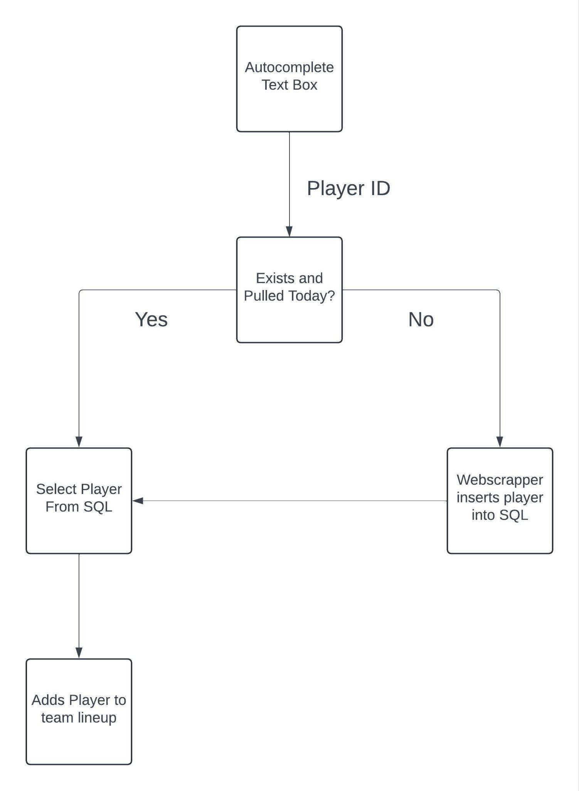
Web Scraper
Initialize Database with Player names and their IDs
Pulls player stats, and groups them based on what team they are on
Pulls current teams active rosters

Slide 5
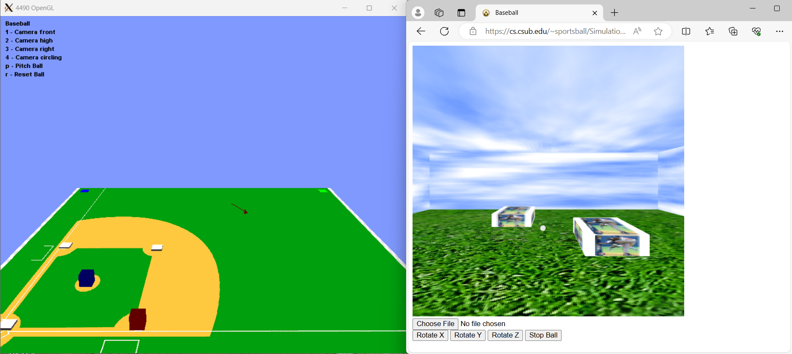
Simulation
OpenGl WebGl
In Webgl = L- move left, R - move right, B- move back, F- move forward
Arrow keys - move ball around

Slide 6
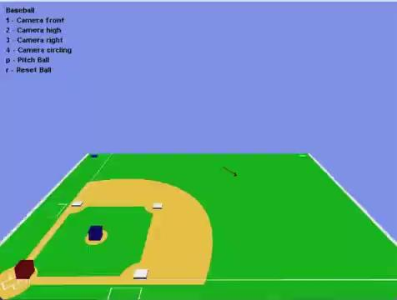
Demonstration

Slide 7

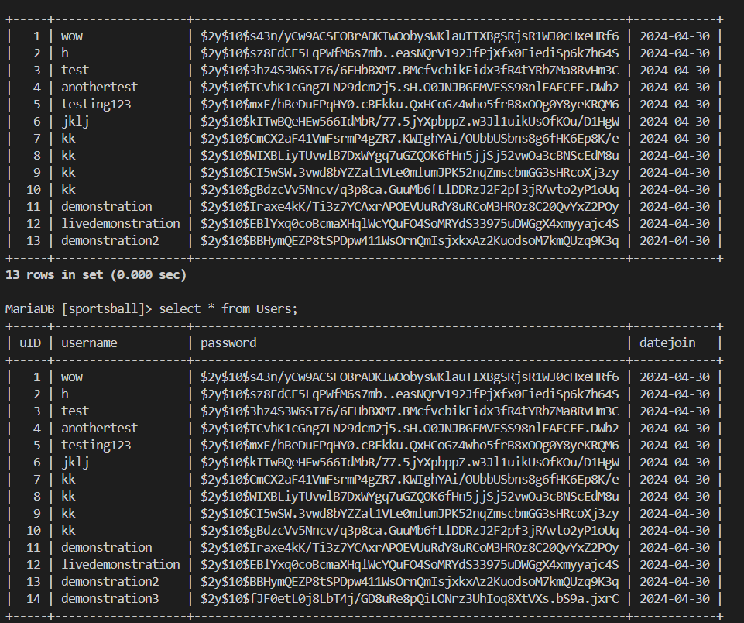
Website Demonstration

