Slide 1

UltraVisionAR
Final Presentation
Alia Almaitah
Joseph Rivera

Slide 2
Overview
Develop an augmented reality application for the purpose of ultrasound training
The user would see arrows on the screen directing which way to move the ultrasound transducer along a fake body

Slide 3
Goals
Develop object detection in our application
Add 3d arrows when detection object to guide user
Setup AR Core in our Application.
Develop User Interface to make application easy to use.
Step-by-Step Guidance
Build a database

Slide 4
Setup AR Core and AR Foundationsa
When developing the 3D arrows, we must establish the ARCore and AR Foundation libraries in our project.
we set up ARCore on our app, like camera permission, Enable AR in your Android app, Verify that ARCore is installed and up to date.

Slide 5
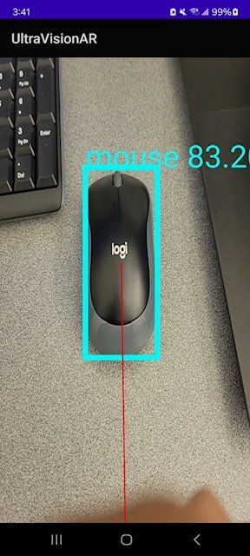
Object Detection
We used a TensorFlow Lite model for object detection.
It's designed to detect the location of a computer mouse.

Slide 6
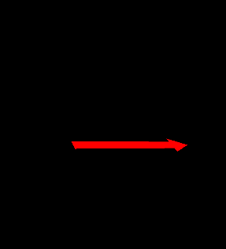
3D arrows
Currently working on development in Unity
We are using OpenGl to draw 3d arrows.
We had some trouble adding 3D arrows to our project, so we used a line on the mouse to show where we wanted to place the other object.

Slide 7
Conclusion
Developed object detection for our mouse object
Created 3D arrows
Next Steps:
Add our 3D arrows into our object detection application
Create UI that helps the user navigate our app

