Slide 1

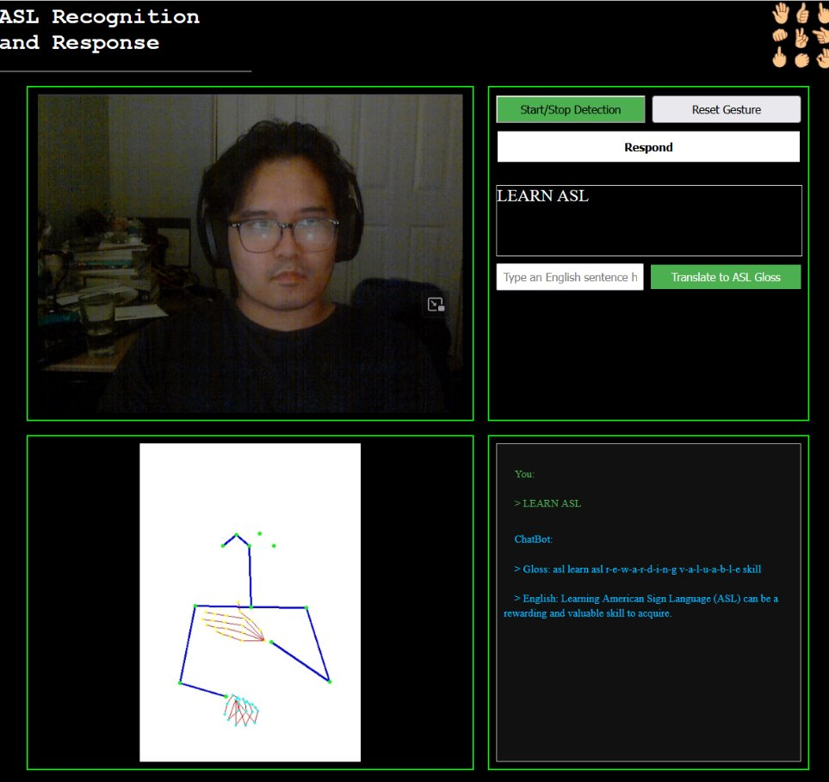


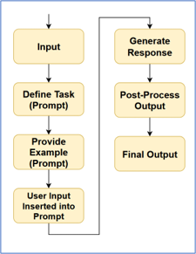
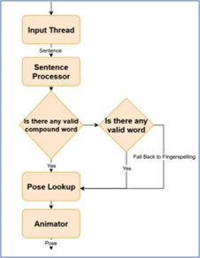






ASL Recognition and Response Program
Marc Angeles | Serafin Arboleda | Joseph Hernandez | Zabdiel Garcia
Introduction
ASL is a language that's used by many people from the Deaf and Hard of Hearing Community. ASL is also a language that requires independent practice to learn successfully. We decided to make practicing this language more interactive and engaging by building a web application that can process your ASL gestures and respond back to you. This project will allow for people to independently practice their ASL.
Project Architecture:
Website
The website has two ways to input and get a response. The first way will have you use ASL fingerspelling. The other one will have you insert text into the website to get a specific response that you want from the chatbot.
The website uses JavaScript to allow for the camera to gain input. This allows for the buttons to work. The website uses python for it to run. The website also uses flask to allow for all the python programs to work together. The website is hosted on Athena to allow the group to not have any hardware issues with the programs
Accessibility
This project is a python-based web application that can be accessed at the URL athena.cs.csubak.edu/asl-rr. Once on the website, you can allow access to your device’s local camera and start signing to start the conversation!
Results
We were able to implement our program via a web application to recognize ASL Gestures and respond in ASL formatted text and/or ASL Gestures using a 2D skeleton. All of the Backend processing is done on the Campus’ Athena Server.
The project is split into three components:
The ASL recognition portion takes ASL fingerspelling from a webcam
The chatbot takes the text output from the ASL recognition.
The ASL Response takes output from the chatbot to produce an animation.
Acknowledgements​
WLASL
One of the largest ASL dataset. We used their key points data for ASL response
Fmahoudeau
We utilized their pretrained MiCT-RANet model as the backbone of our recognition pipeline
Dr. Chengwei Lei
Our sincere thanks for your insightful feedback and encouragement throughout this project
Dr. Alberto C. Cruz
Thank you for helping us get started on Athena, guiding us through the platform's use as well as maintaining it.
Recognition
Chatbot
Response
Technology Used
College of Natural Sciences, Mathematics, and Engineering Department of Computer and Electrical Engineering and Computer Science

