Slide 1

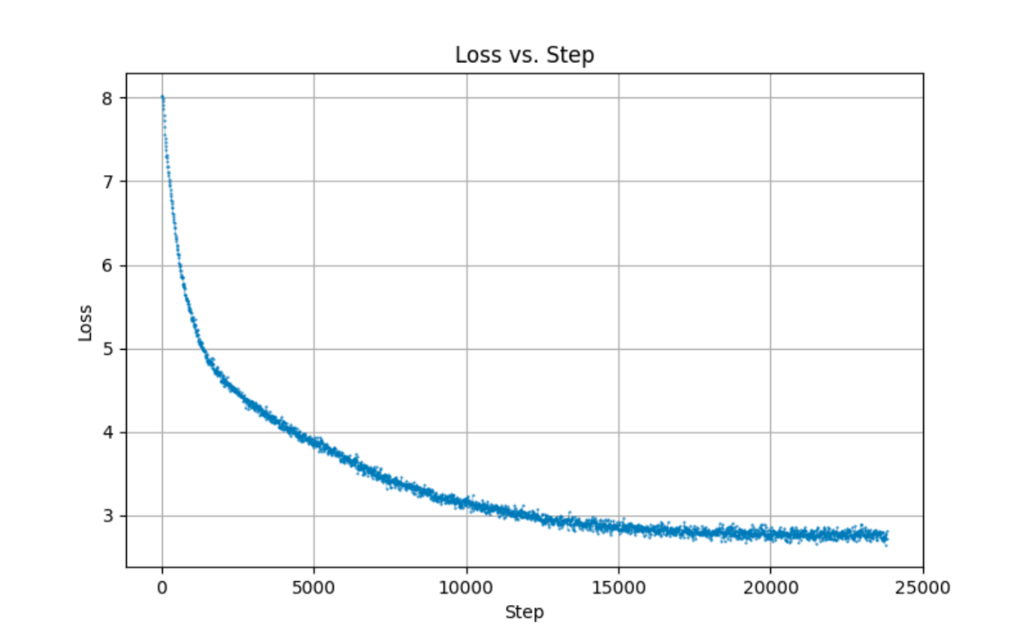
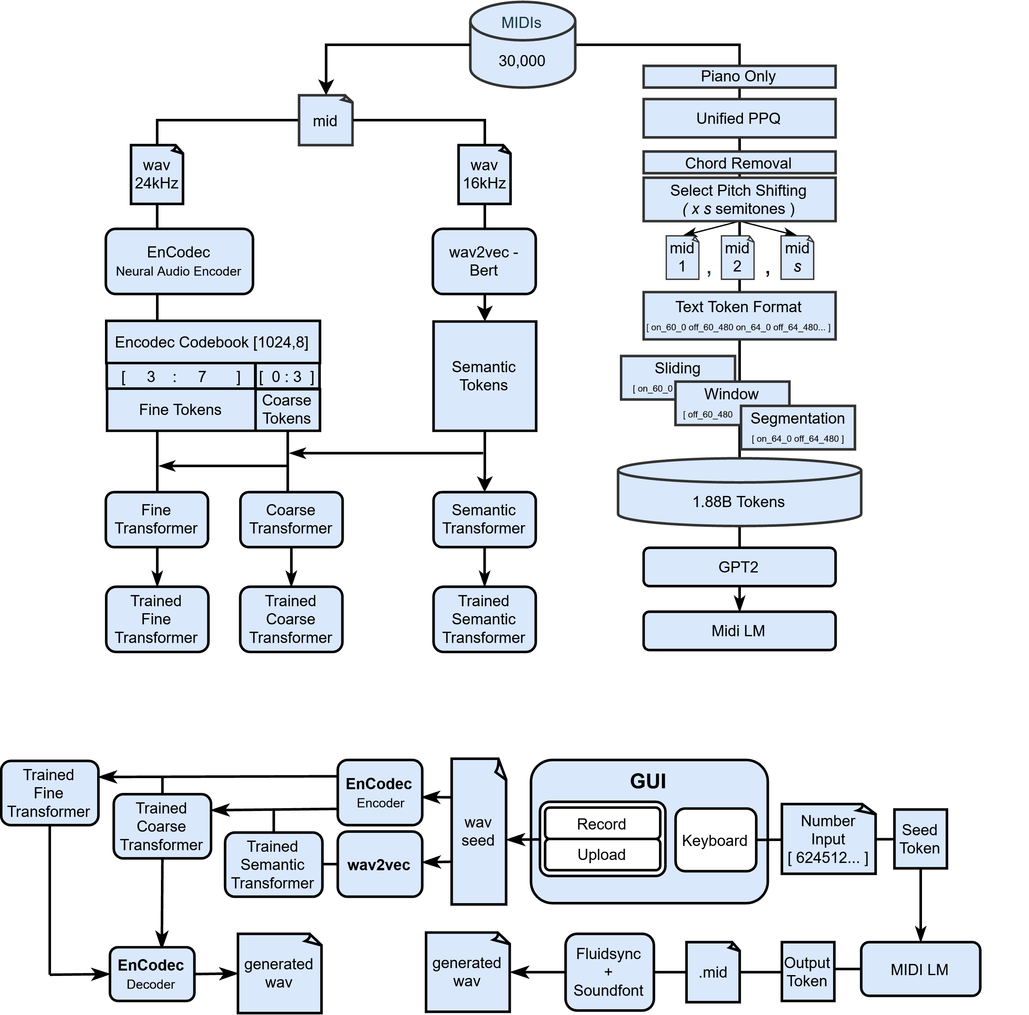
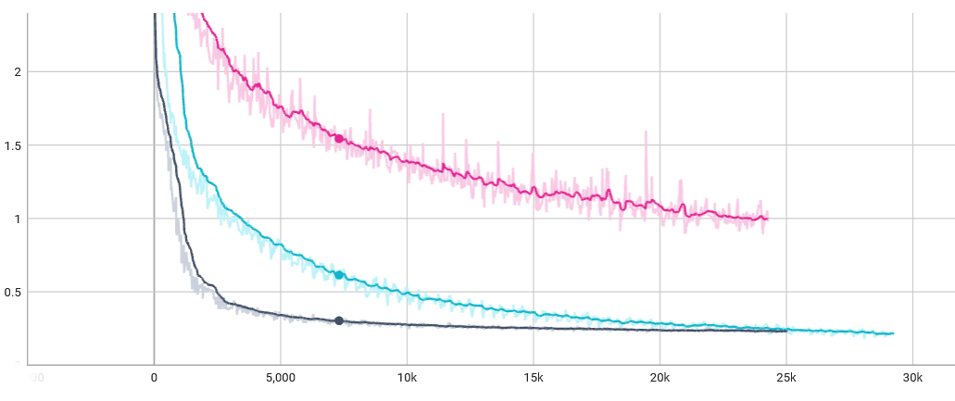
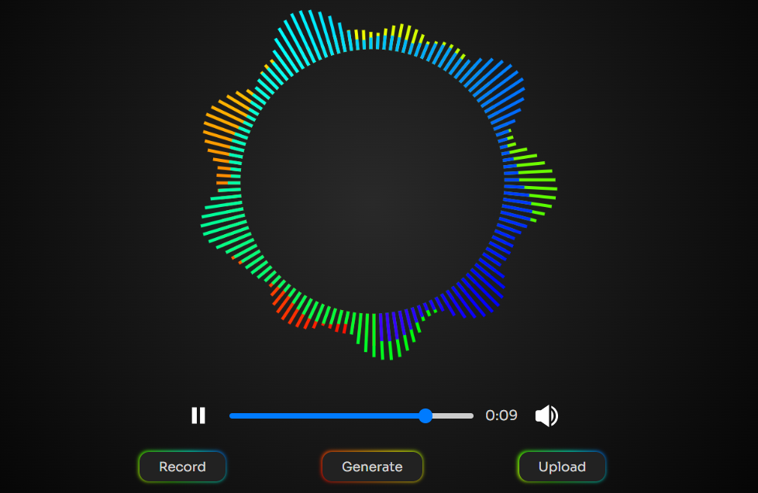
LLM-Based Music Generation Using
Beat-Standardized MIDI Tokens
Huaiyu Zhang, Braden Stitt, Dominic Flores, Michael Kausch, Chengwei Lei
Introduction
This project explores symbolic music generation using beat-standardized MIDI tokens and a large language model (LLM). MIDI data is preprocessed into rhythm-aligned sequences with consistent tempo and structure, allowing the model to better capture musical patterns. We train GPT-2 to predict these beat-based tokens, enabling it to generate coherent melodies that can be rendered into audio.
We believe the beat alignment improves temporal consistency and helps the model generalize across styles. Output quality is evaluated using Fréchet Audio Distance (FAD) and SHA-256 hashing to ensure novelty. This work also serves as a comparative baseline against waveform-based models such as AudioLM.
Tokenization
Training
GPT2
Training
Loss
AudioLM
To transform musical input into a format suitable for language modeling, we implemented a custom tokenization pipeline for MIDI’s. This approach converts simplified numerical notation into a structured sequence of text-based tokens representing musical events and was compared against AudioLM, a state-of-the-art hierarchical transformer architecture developed by Google.
AudioLM
Midi LM
User Interface
We developed a browser-based graphical user interface (GUI) using ReactJS and Vite. Users can: Upload or record audio in the browser, trigger symbolic or waveform-based generation, and playback and download generated results.
Node.js + ExpressJS server routes client requests and triggers Python scripts to process audio within isolated environments, ensuring compatibility and reproducibility.
Acknowledgements
Dr. Lei for his excellent guidance, feedback and inspiration throughout this project. Dr. Cruz for allowing us use of his research server.
GPT2 Model
Autoregressive Learning: Ideal for generating temporally coherent music by predicting one token at a time.
Transformer Architecture: Captures long-range dependencies crucial for musical structure.
Lightweight & Customizable: Models offer a balance between performance and resource efficiency.
Benefit: reduced training overhead while maintaining sequence quality.
User Interaction / Data Flow
Datasets
MidiLM: ADL Piano (~11,000 piano MIDI)
AudioLM: Dopeloop (~30,000 procedurally generated MIDI)
College of Natural Sciences, Mathematics, and Engineering Department of Computer and Electrical Engineering and Computer Science

