Slide 1
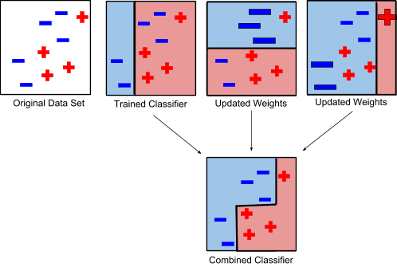
Automated Analysis of Cellular Microscopy Images
Anthony Bianchi (mentor) and Jacob French (assistant)
abianchi1@csub.edu, Department of Computer and Electrical Engineering and Computer Science
Teams: Applesauce : Biola Makinde, Suchitra Dara Purple : Rocio Robles, Natalie Carrillo Detective Cells : Arlette Martinez, Christopher Chuc Tuff : Tranis Nguyen, Josh Villa, Andrea Gomez
Abstract
Adaboost Classifier
There has been an influx of large-scale microscopy image analysis of biological systems. The problems being solved by this analysis include but are not limited to fundamental call mechanics, disease prediction and analysis and drug discovery. Traditionally the analysis of these microscopy images has been manual which can be time prohibitive due to the large number of samples needed to be statistically significant and can lead to operator variability. These problems lead to the need for automated image analysis. The students in the project have learned how to program in MATLAB to implement an image level classifier that classifies an image as cancer or normal tissue. They used the PatchCamelyon dataset which holds 327k color H&E stained images of lymph node sections and tried to detect if the image was of a metastasized tumor. The students where split into teams and used the Adaboost Classifier as their base. Each team then designed their own features to train the classifier. Which team will get the best results?
Kmeans
AdaBoost (adaptive boosting) is an ensemble machine learning algorithm that adds multiple weak learners (classifiers that are only slightly correlated to the true classifier) to generate a single composite strong learner (a classifier that is well-correlated to the true decision surface). During each round of training, a new weak learner is added to the ensemble and a weighting vector is adjusted to focus on examples that were misclassified in previous rounds. The result is a classifier that has higher accuracy than the weak learners’ classifiers.
Entropy
Adaboost Training
Technical Approach
Cancer
Normal
Experimental Results
The weak classifier used in this project were decision stumps where a single feature is used. If the value of the feature is above a threshold it is classified as one of the classes.
Using this weak classifier allows for inherent feature selection, which means a large number of features can be evaluated and only the best are chosen. Other classifiers can become confused by bad features.
Also, since the decision stumps are used we do not have to worry about feature normalization since they are not combined together to make a decision surface.
Offline
Feature Generation
Database of Microscopy Images
Feature Extraction
Train Classifier
RGB
HSV
To describe the color of the images we took each individual color channel (RGB) and calculated the statistics of the histograms (mean, variance, skewness and kurtosis). We also change the color space to HSV and did the same statistics.
New Patient (?)
Cancer Prediction
Color Features
New Image
Feature Extraction
Evaluate Classifier
There is Cancer!
Conclusions
A supervised learning approach was taken where we have a database of images with labels of cancerous or normal tissue. We used the PatchCamelyon dataset of H&E Microscopy images which has 327K images ( we used a subset due to time constraints).
The training is done offline and can take days to complete. When a new image needs to be classified we evaluate the classifier, which is fast, to get a prediction of cancerous or normal tissue.
The student developed their own features to summarize the images so the classifier could make a decision.
Detect Circles
Edge Detection
Gabor Filters
We detected circles and counted them. The sum of the edges gives an idea of the complexity of the space. Gabor filter sums give a more specific idea of the edge directions.
Each team
Structure Features

