Slide 1

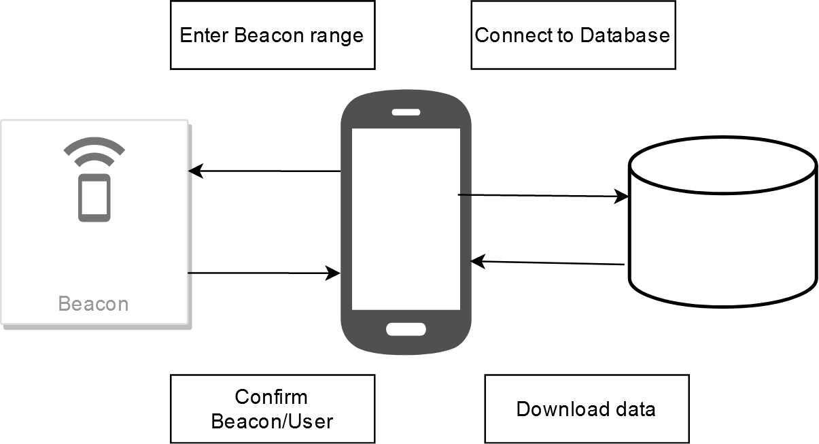
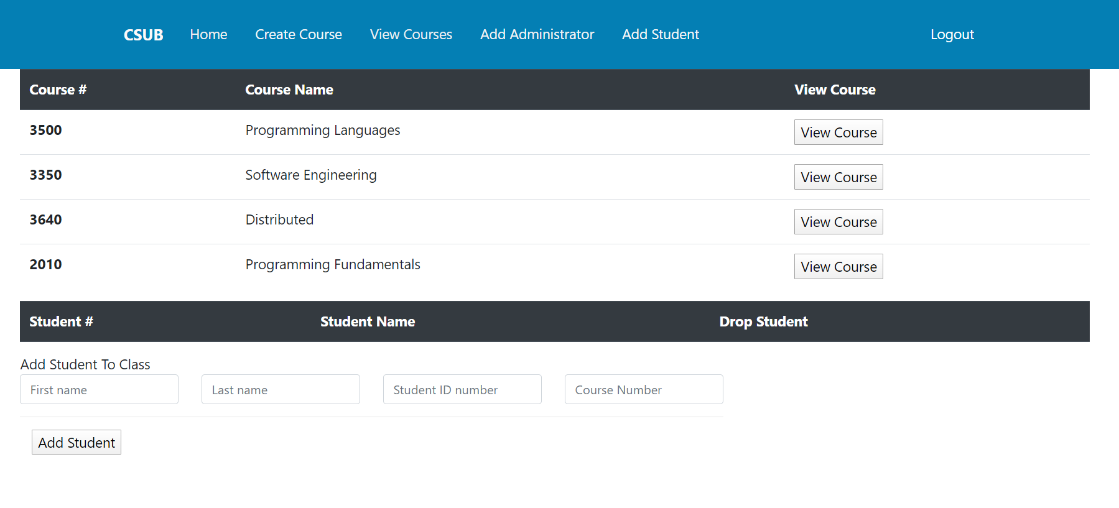

WhatsDue
By
CSU Bakersfield
School of Natural Sciences, Mathematics, and Engineering
Eddie Ekpo, Edwin Hernandez, Nicholas Kalar
Abstract
  Students juggling several courses often leads to confusion when information delivery may vary from each professor. As of now, the CSUB Computer Science departments offers five different methods of delivering syllabi and classroom documents.
  Our project utilizes Bluetooth Low Energy Beacons (BLE Beacons), an Android application built using Kotlin, a web portal for uploading files and adjusting syllabi, and a backend SQL database to deliver a seamless experience for students.
  Once within range of a Bluetooth beacon, students would be automatically updated with the latest course information or syllabus revision. BLE beacons allow for mobile devices to be sent relevant location-based information.
Significance of WhatsDue
WhatsDue’s primary purpose is to simplify the lives of students. Students have multiple sources to obtain vital classroom information. Some of this information may include assignment due dates, upcoming exams and professor contact information. WhatsDue helps eliminate the stress of students having to rely on multiple sources for their syllabus needs. Within the application, students may access a dynamic list of their courses where their syllabus is just a tap away.
Limitations
WhatsDue has a small userbase since it targets college students.
RSSI is unpredictable at times
Cannot store data on Bluetooth Beacons
Reliant on students being around Classrooms
Requires a phone for students
Results
WhatsDue is a functioning application that will dynamically display a student’s current course load as well as each syllabi for the respective course. The front-end website has also successfully been deployed to help professors easily access their course syllabi, students enrolled in each course as well as the ability to add or drop any students.
What does it do?
The application detects when a Bluetooth beacon is within detectable range. Once WhatsDue has confirmed connection with a beacon, a database query begins for the specific user who is signed in. The query searches for the user’s course schedule as well as returns a Boolean value which determines if any changes or updates have been made to a course. If changes are found, the application downloads the updated syllabus and populates it to the user. The query only occurs when a student resides within range of a Bluetooth beacon. The WhatsDue website also serves as a tool for professors to easily update syllabi as well as the student roster.
Why
With the growing number of platforms CSUB utilizes to distribute basic classroom documents, an easy-to-use automated application to distributed classroom syllabus would be beneficial to faculty and students. The application accesses a database using a BLE beacon as a medium, once a device is within range of said beacon, a database query is initiated to see if any syllabus changes have been made. This automated service eliminates the student’s need to check multiple platforms for coursework.
Languages/Libraries
Bluetooth beacons
Implementation of RSSI
Kotlin
HTML, CSS, Bootstrap Studio
Handlebars
Node.js, Express
MySQL
Eddystone API
Department of Computer and Electrical Engineering and Computer Science

